Slide 1
Multi-Agent Architectures
Coordinators, subagents, handoffs and guardrails — with running code
Notes:
Welcome. Three hours: concepts, then code you can run. Every demo uses a real Python agent loop on the Anthropic Messages API.

Slide 2
The next three hours
1
From chat to agent
The agentic loop, stop_reason, message history
2
Coordinators & subagents
Hub-and-spoke, delegation, parallel fan-out
3
Context & handoffs
Blank-slate subagents, structured findings, provenance
4
Guardrails
Hooks, tool design, errors, escalation
5
Reliability at scale
Error propagation, context rot, bug hunt, wrap-up
10-minute break at 1:15
Notes:
Timings are a guide; Parts 2 and 4 are the heaviest and carry the live demos.

Slide 3
1
PART 1
From chat to agent
Every multi-agent system is several of these loops talking through a coordinator.

Slide 4
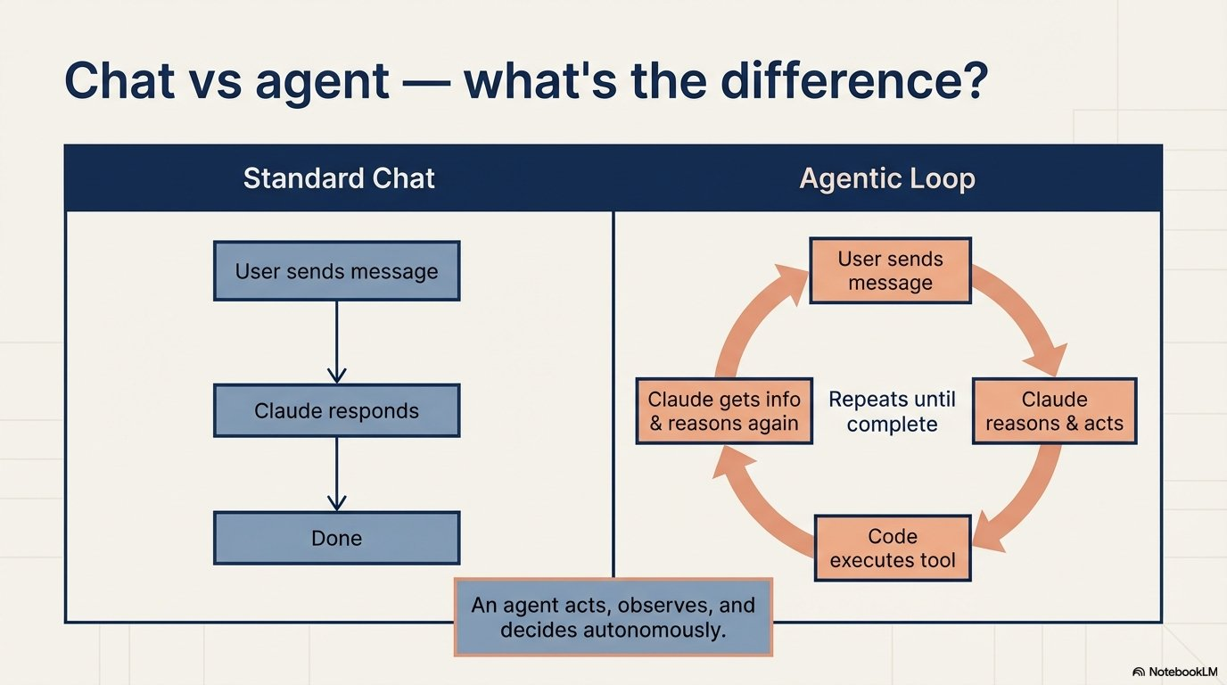
Notes:
Chat: one request, one answer. Agent: the model decides what to do next, acts through tools, observes, repeats.

Slide 5
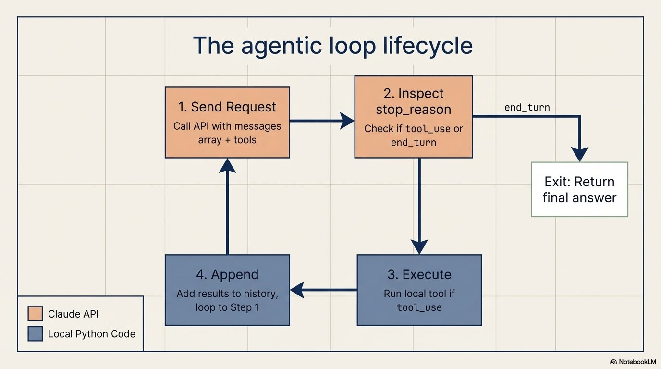
Notes:
Four steps. Only step 1 and 2 involve Claude; execution and appending are YOUR code. Exit on end_turn.

Slide 6
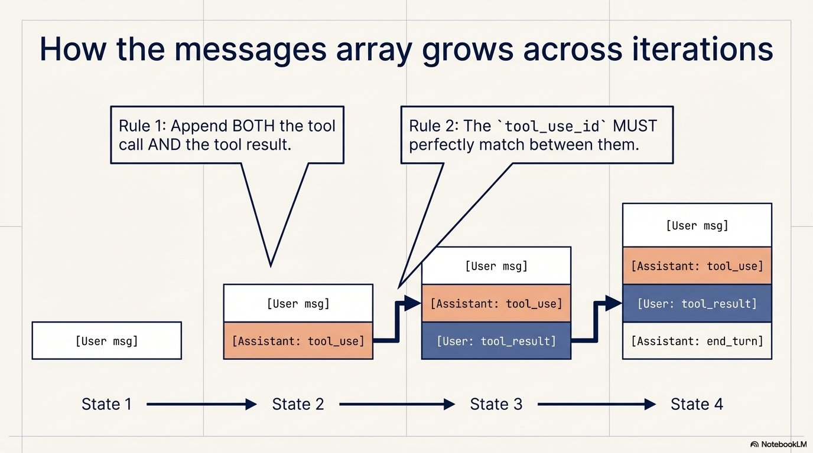
Notes:
The API is stateless. Every call carries the whole history. Append the assistant tool_use turn first, then the tool_result with the matching tool_use_id.

Slide 7
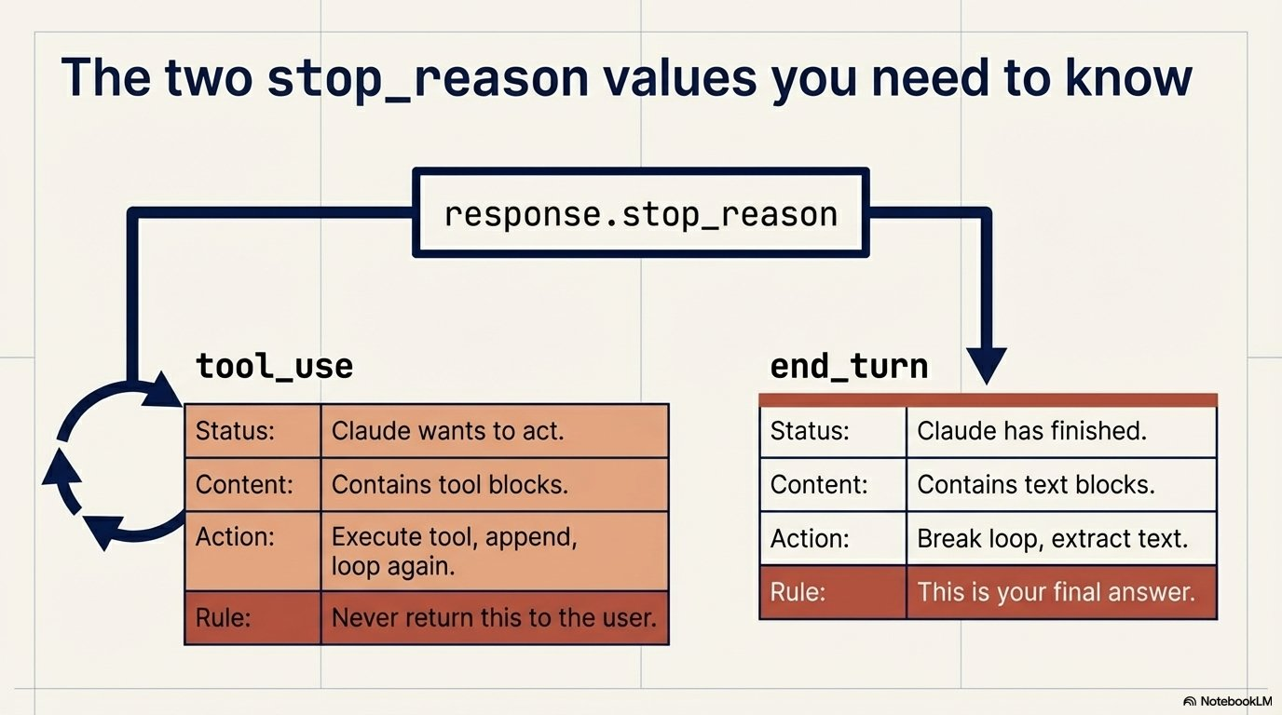
Notes:
Only two values matter day to day: tool_use (keep going) and end_turn (done).

Slide 8
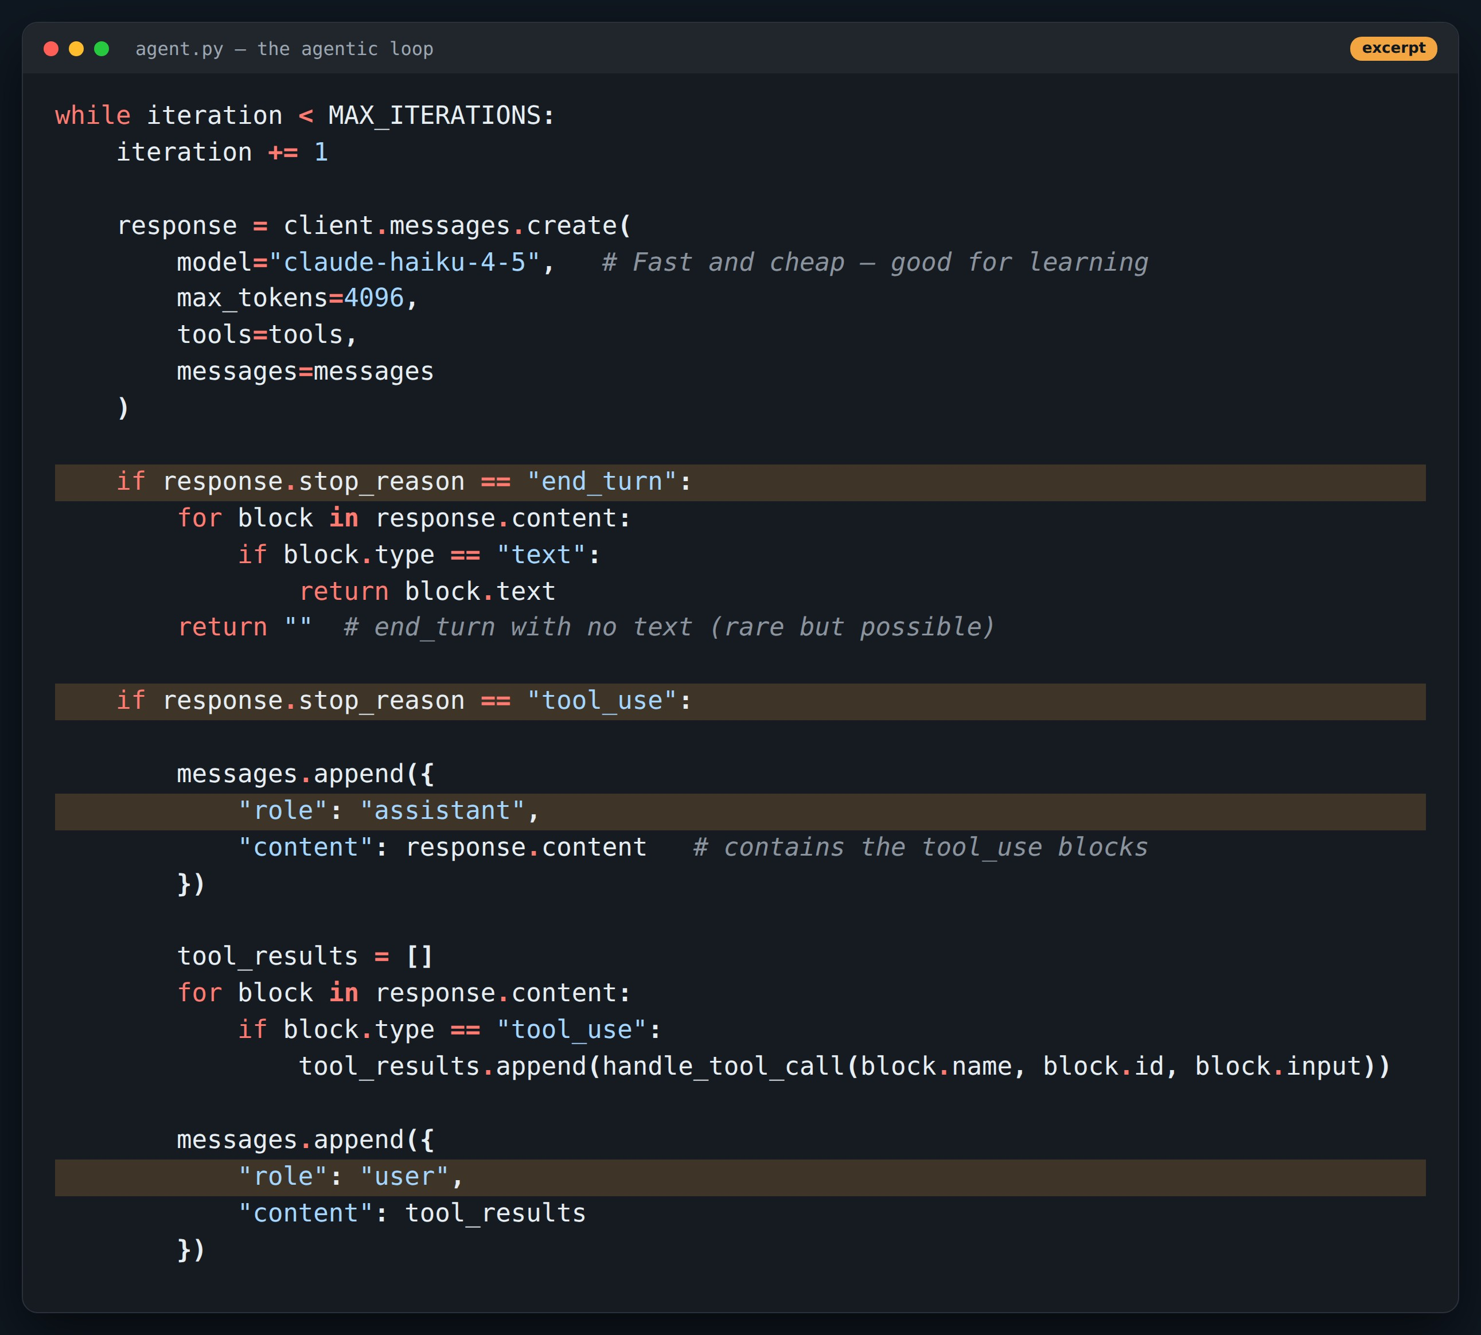
CODE
The agentic loop, line by line
Point at
1
Exit only on stop_reason == "end_turn"
2
Append the assistant turn with its tool_use blocks
3
Tool results go back as a user turn
4
MAX_ITERATIONS is a safety valve, not the stop rule
Code excerpt, comment lines trimmed.
Notes:
Walk top to bottom. Ask the room: what breaks if we append results before the assistant message? (400 error: tool_result without matching tool_use.)

Slide 9
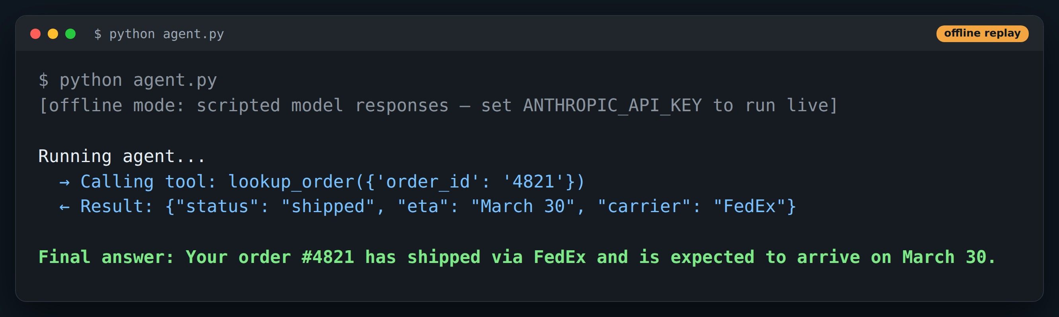
DEMO
agent.py running
Point at
1
Model asks for lookup_order('4821')
2
Our code runs the tool — Claude never executes it
3
Second call sees the result and ends the turn
Offline replay: real demo code, scripted model responses. Re-run with ANTHROPIC_API_KEY for live output.
Notes:
Two model calls, one tool call. This trace is the unit we will multiply in Part 2.

Slide 10
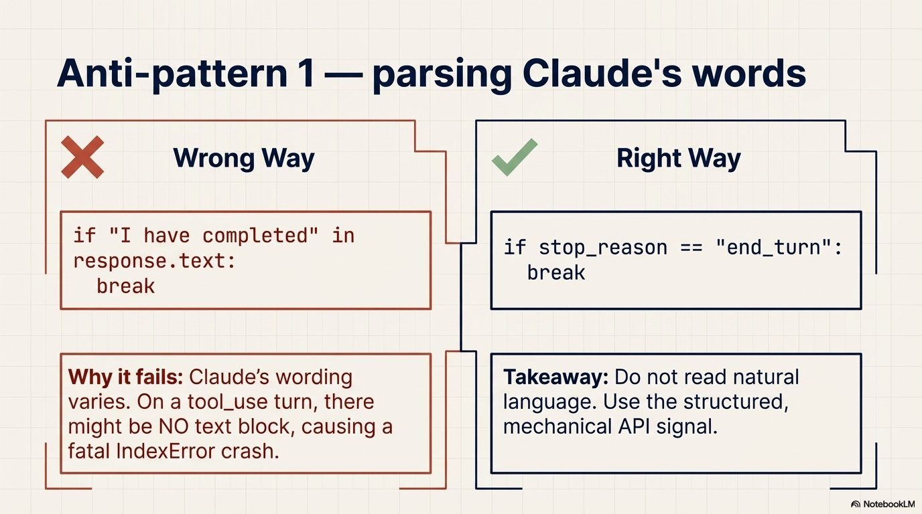
Notes:
Never parse the model's prose to decide control flow.

Slide 11
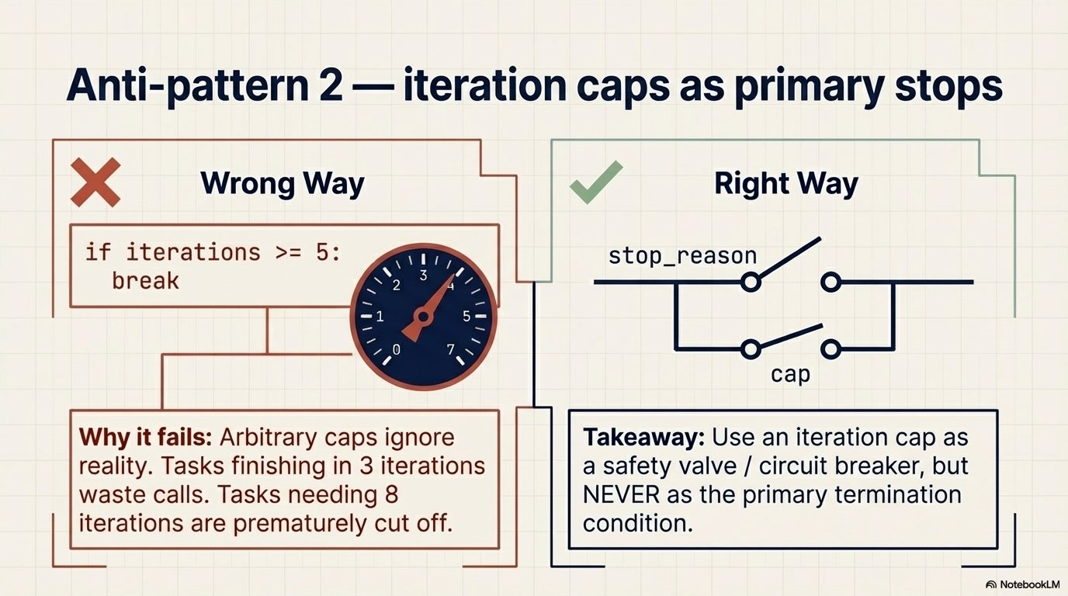
Notes:
Caps cut off long tasks and waste calls on short ones. Keep one as a circuit breaker only.

Slide 12
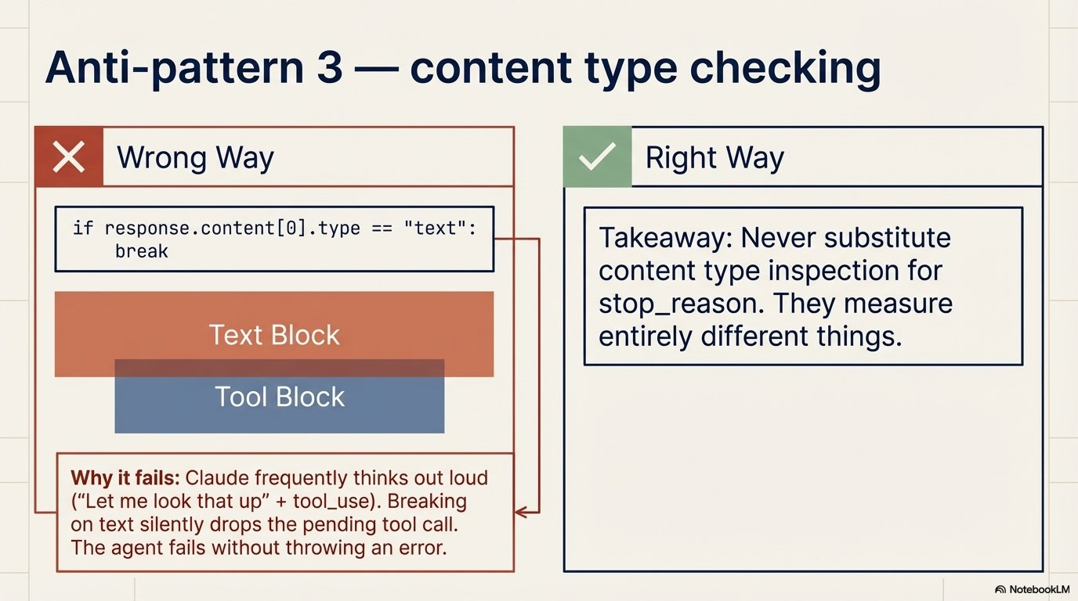
Notes:
A text block can come before a tool_use block in the same response. Checking content[0].type drops the tool call.

Slide 13
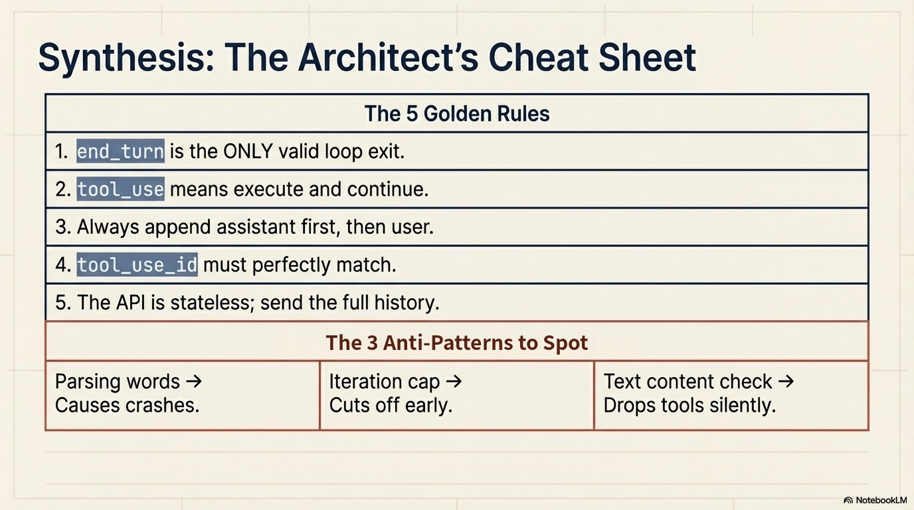
Notes:
Recap of Part 1: the five rules are the point.

Slide 14
2
PART 2
Coordinators & subagents
Why one agent stops scaling, and the hub-and-spoke pattern that fixes it.
≈ 45 min

Slide 15
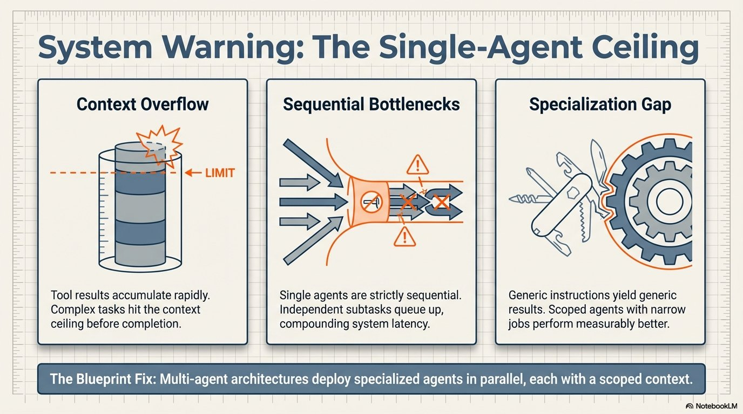
Notes:
Three ceilings: context fills up with tool output, work is serial, and one generic prompt does everything averagely.

Slide 16
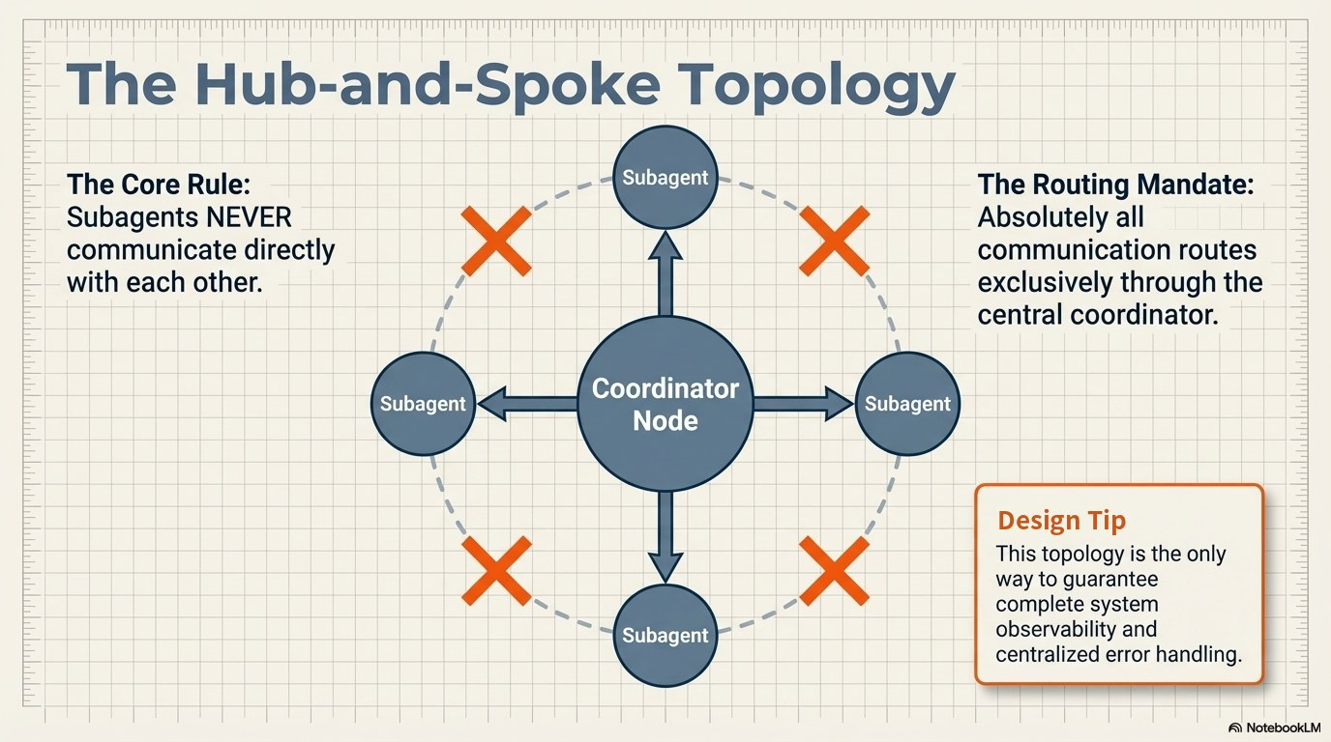
Notes:
All traffic through the coordinator. That's what gives you one place for observability, retries and error handling.

Slide 17
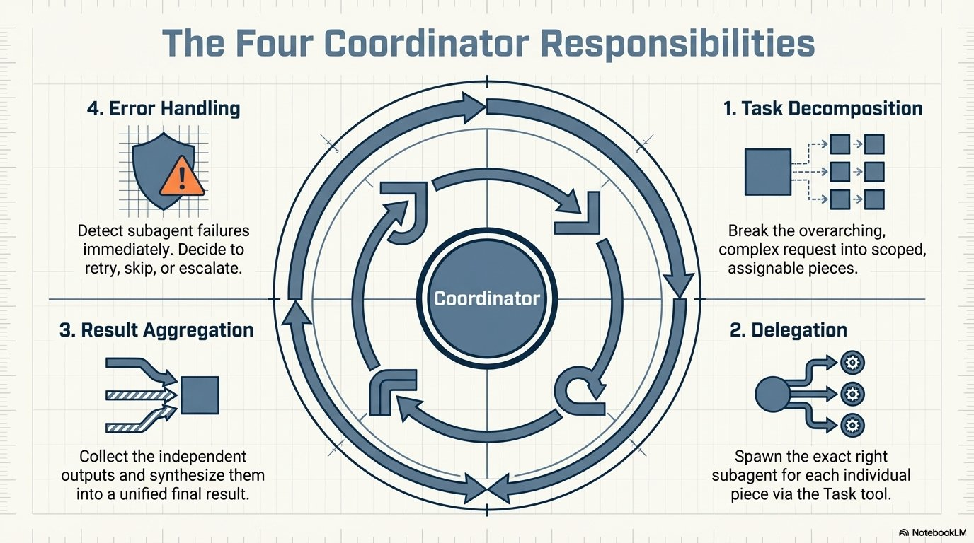
Notes:
Decompose, delegate, aggregate, handle errors. If a coordinator skips one of these, that is where the system fails.

Slide 18
A note on the “Task tool” you'll see on the next slides
1
In Claude Code / Agent SDK
2
On the raw Messages API
3
Same architecture
Subagents are spawned by a built-in Task tool. The coordinator passes description, prompt, allowed tools and model.
There is no built-in Task tool. You define your own tool (our spawn_subagent) and your code runs a new agent loop for it.
Either way: the subagent gets only what the coordinator writes into its prompt, and only the tools you allow.
Notes:
These slides use Claude Code / Agent SDK vocabulary. A built-in "task" tool isn't a Messages API feature — that's why parallel_coordinator.py defines its own spawn_subagent tool.

Slide 19
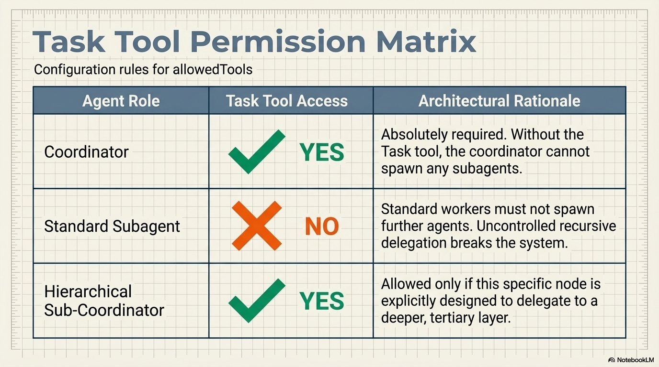
Notes:
Least privilege for delegation: workers shouldn't spawn workers unless designed as sub-coordinators. Stops runaway recursion.

Slide 20
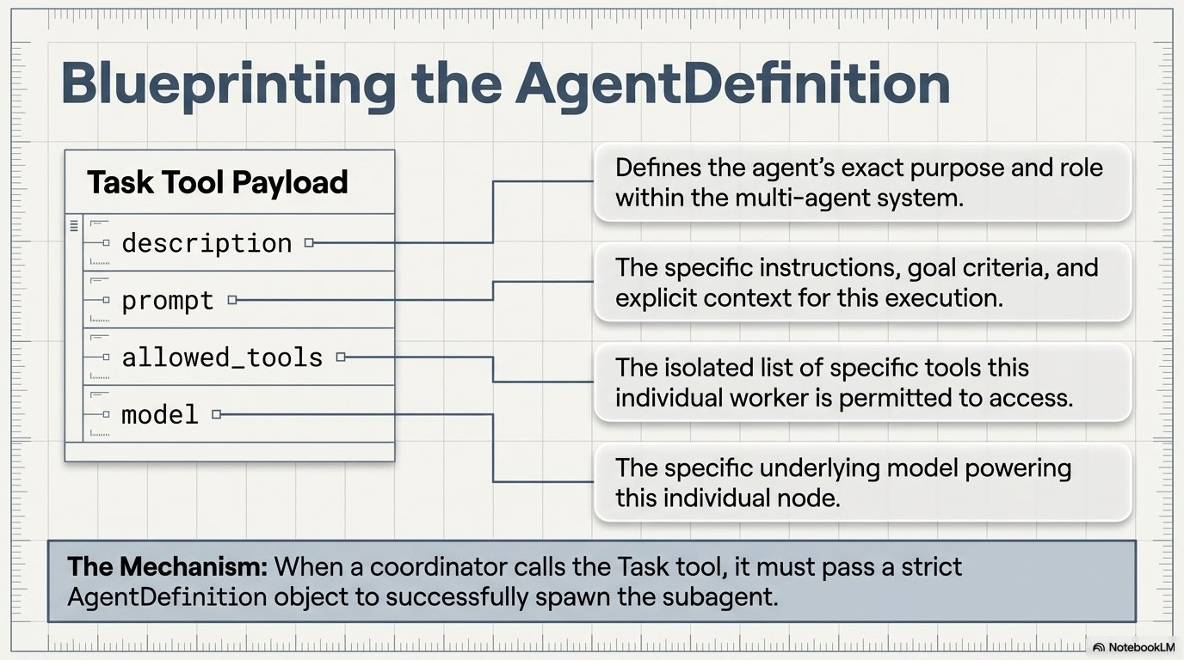
Notes:
The subagent's whole world is these four fields.

Slide 21
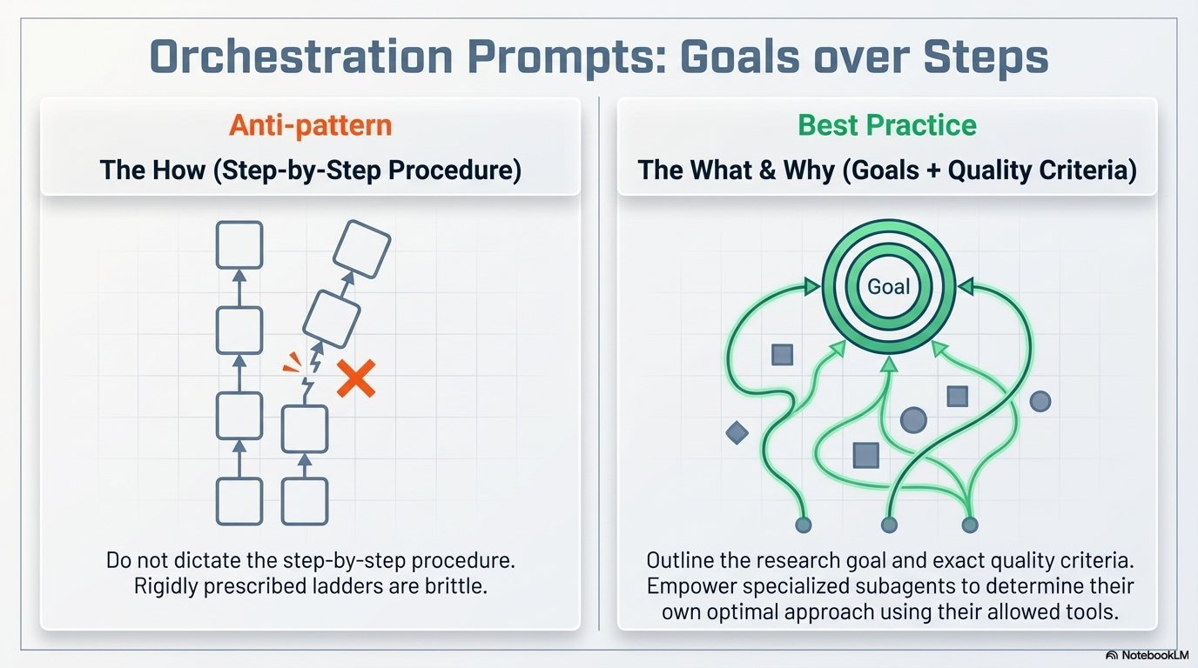
Notes:
Give subagents goals and quality criteria, not step-by-step recipes. They choose how to use their tools.

Slide 22
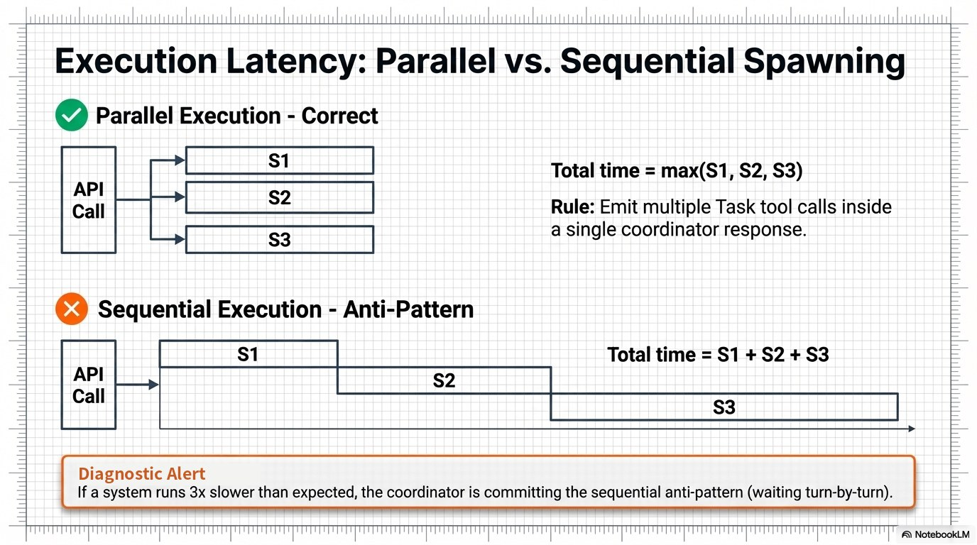
Notes:
Parallelism comes from emitting several tool calls in ONE response, then running them concurrently.

Slide 23
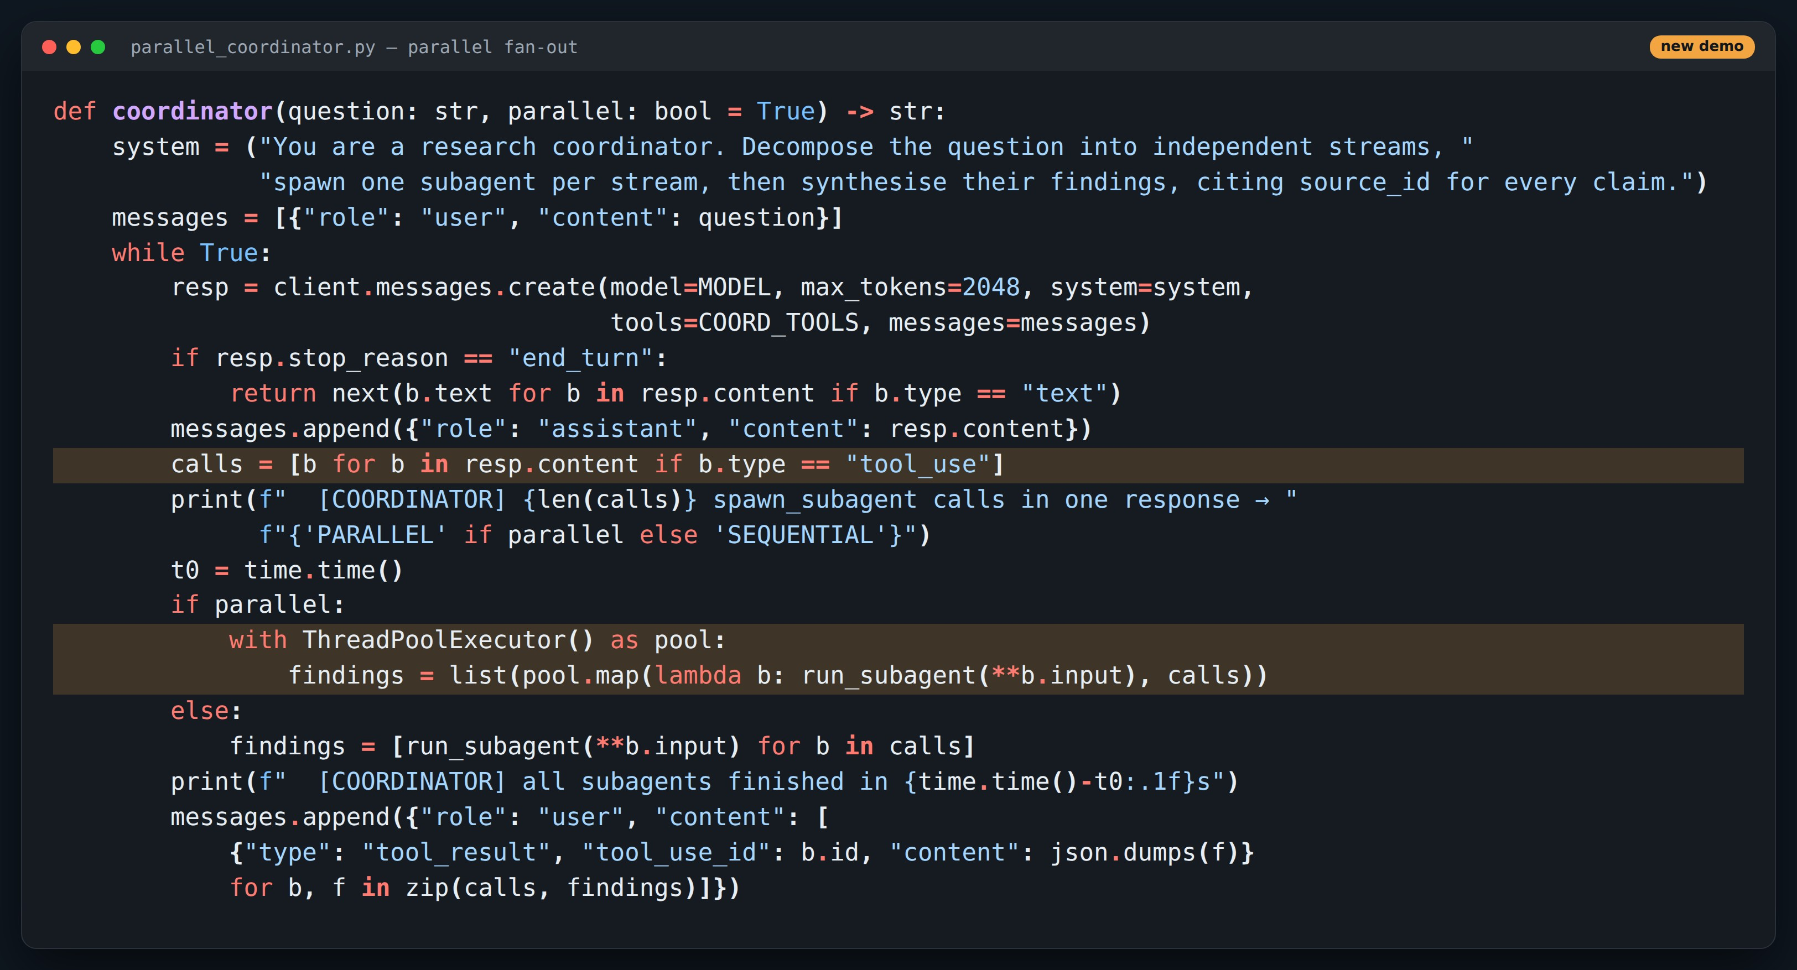
CODE
Parallel fan-out in the coordinator
Point at
1
Collect every tool_use block from one response
2
ThreadPoolExecutor runs the subagents concurrently
3
Each finding returns as a tool_result with its tool_use_id
Companion demo code.
Notes:
The only difference between parallel and sequential is the if/else in the middle. Latency becomes max(S1,S2,S3) instead of the sum.

Slide 24
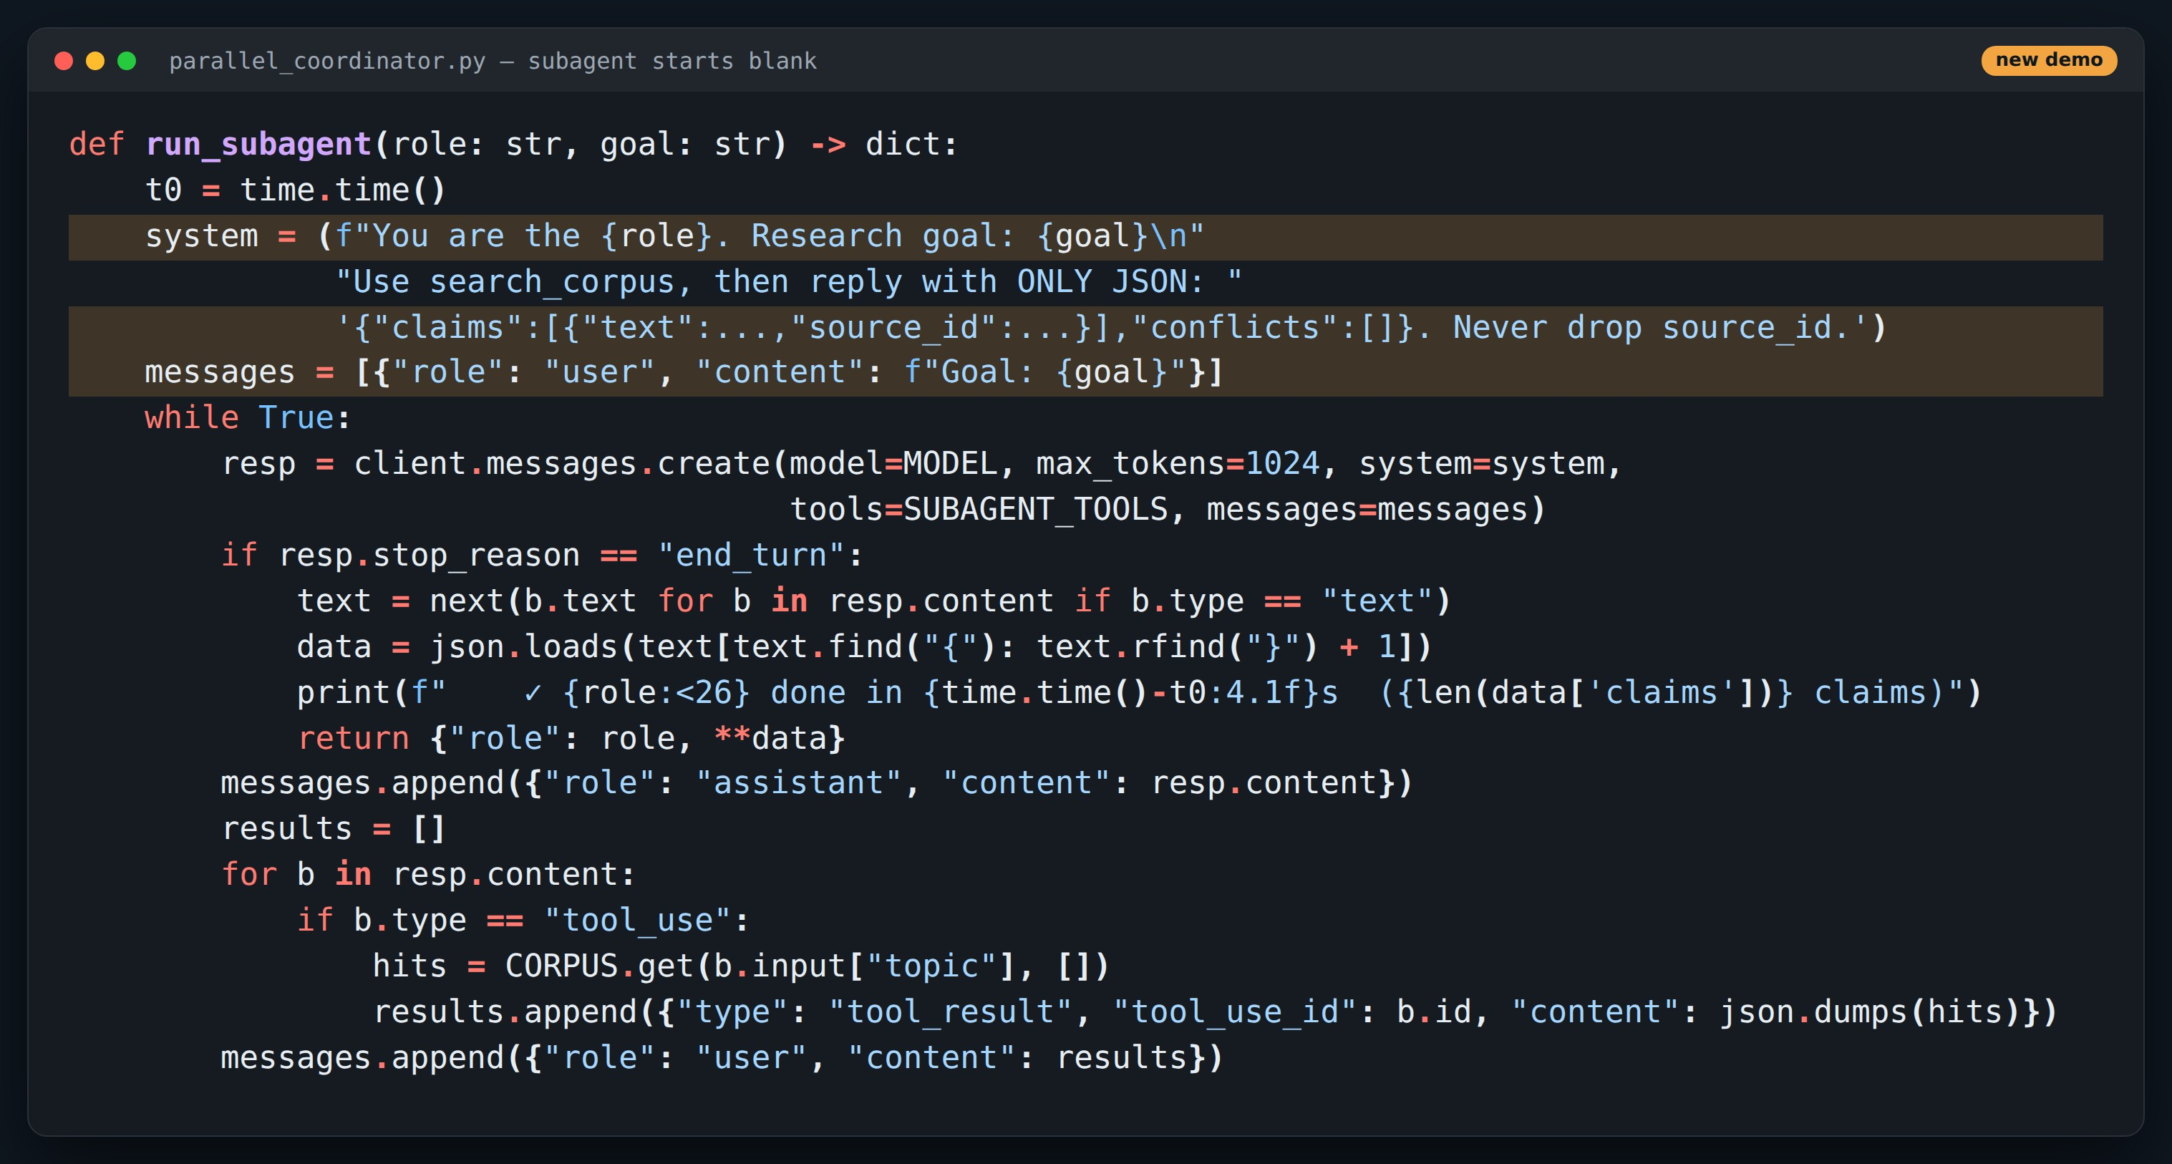
CODE
Each subagent is its own loop
Point at
1
System prompt built only from role + goal
2
Its own narrow toolset: search_corpus
3
Must return JSON with claims and source_id
Companion demo code.
Notes:
Nothing from the coordinator's history leaks in. That's a feature (focus, small context) and a risk (missing info) — Part 3.

Slide 25
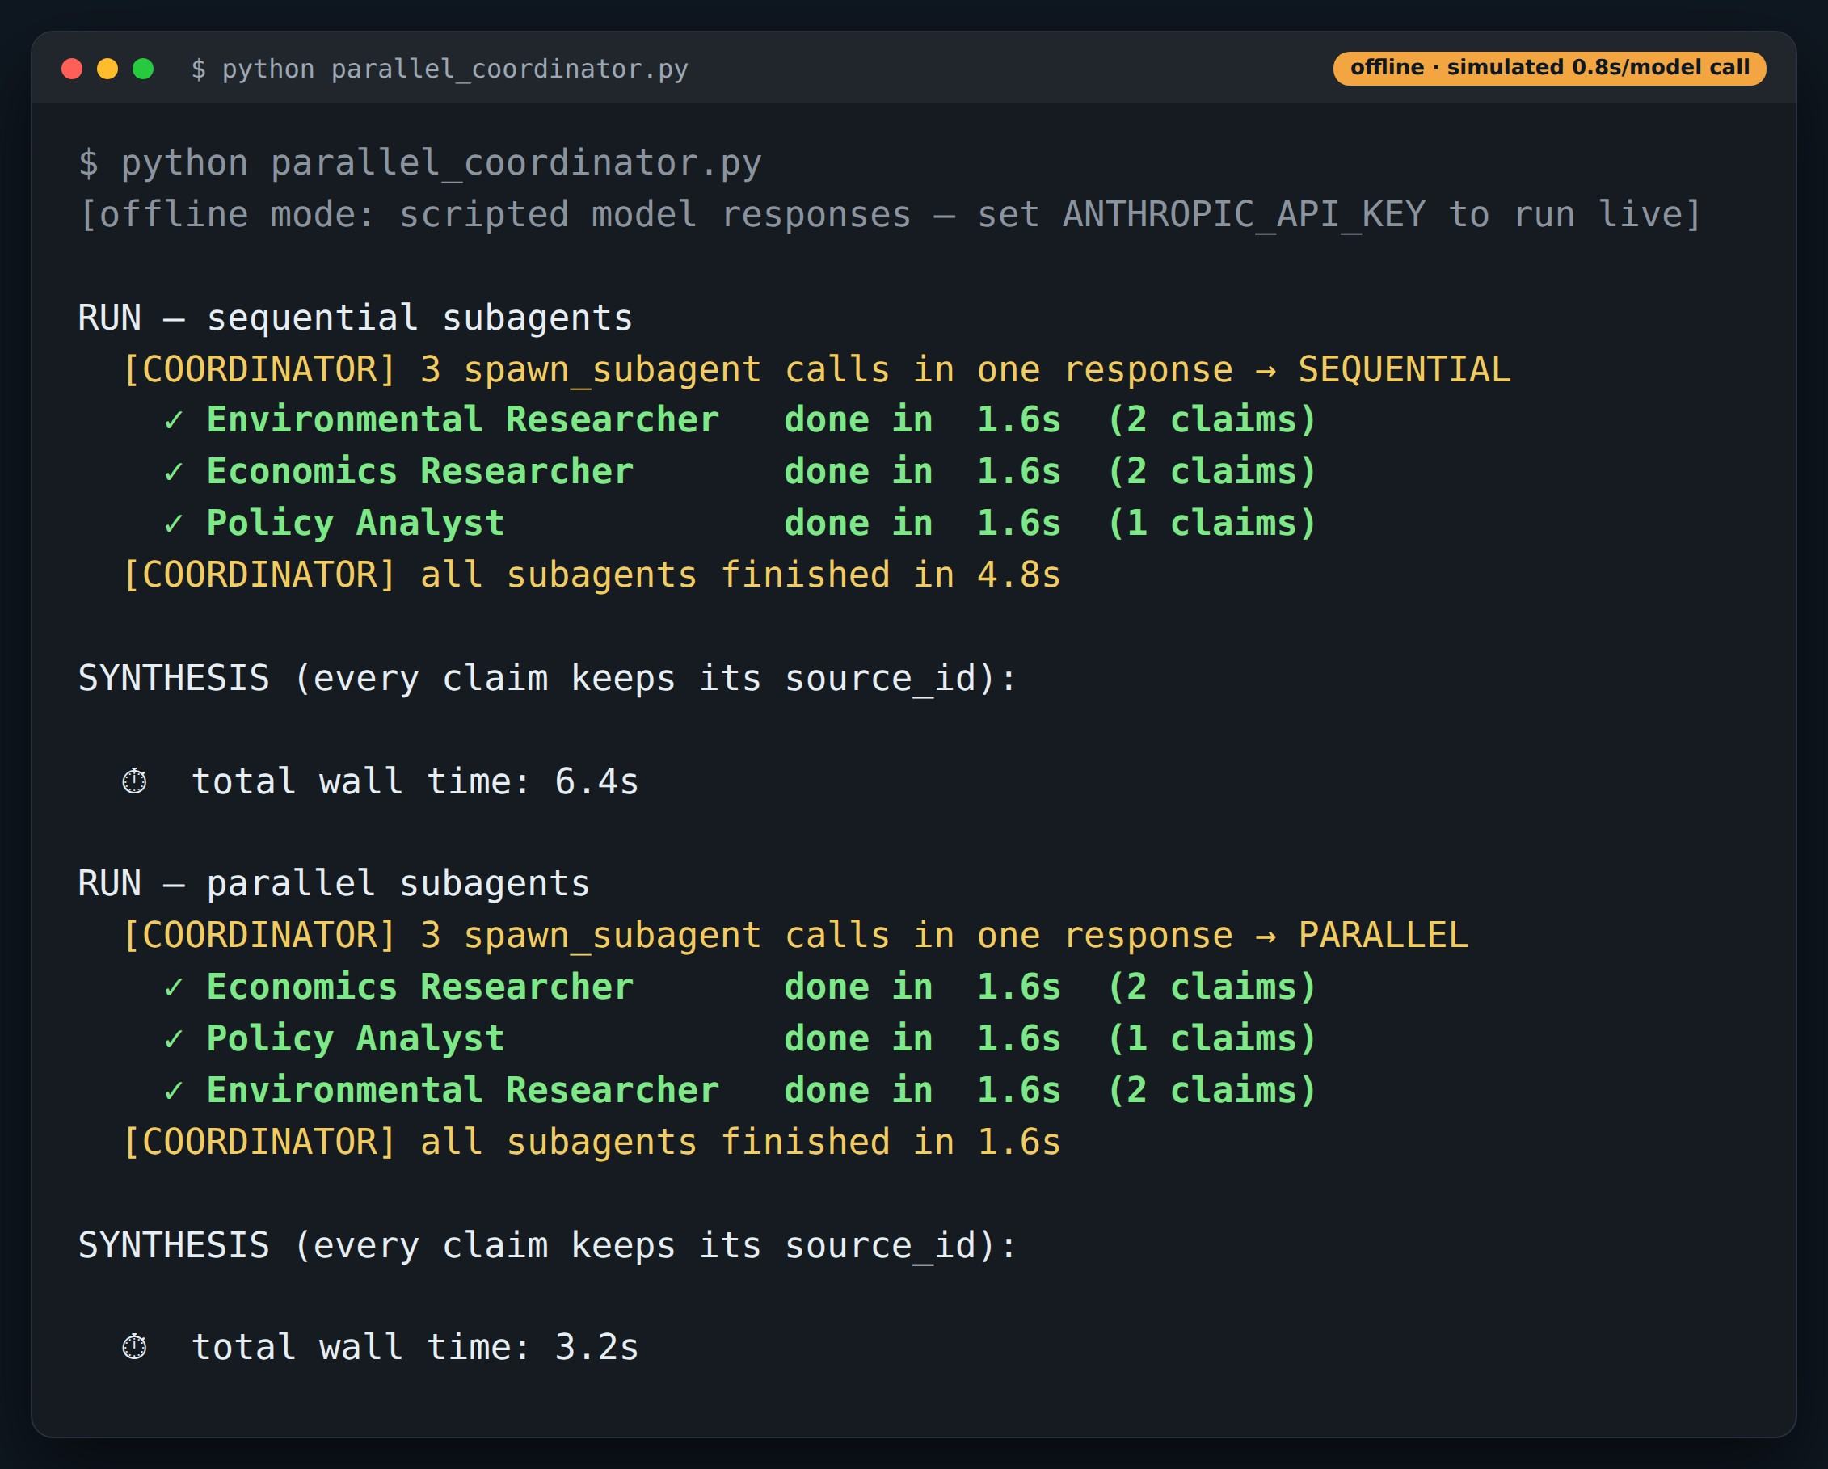
DEMO
Sequential vs parallel: subagent phase 3× faster
Point at
1
Coordinator emits 3 spawn_subagent calls at once
2
Sequential: 4.8 s for the subagents
3
Parallel: 1.6 s — the slowest one sets the pace
Offline replay: real demo code, scripted model responses. Re-run with ANTHROPIC_API_KEY for live output.
Notes:
Latency here is simulated at 0.8 s per model call so the comparison is repeatable offline. Live numbers will vary but the shape holds.

Slide 26
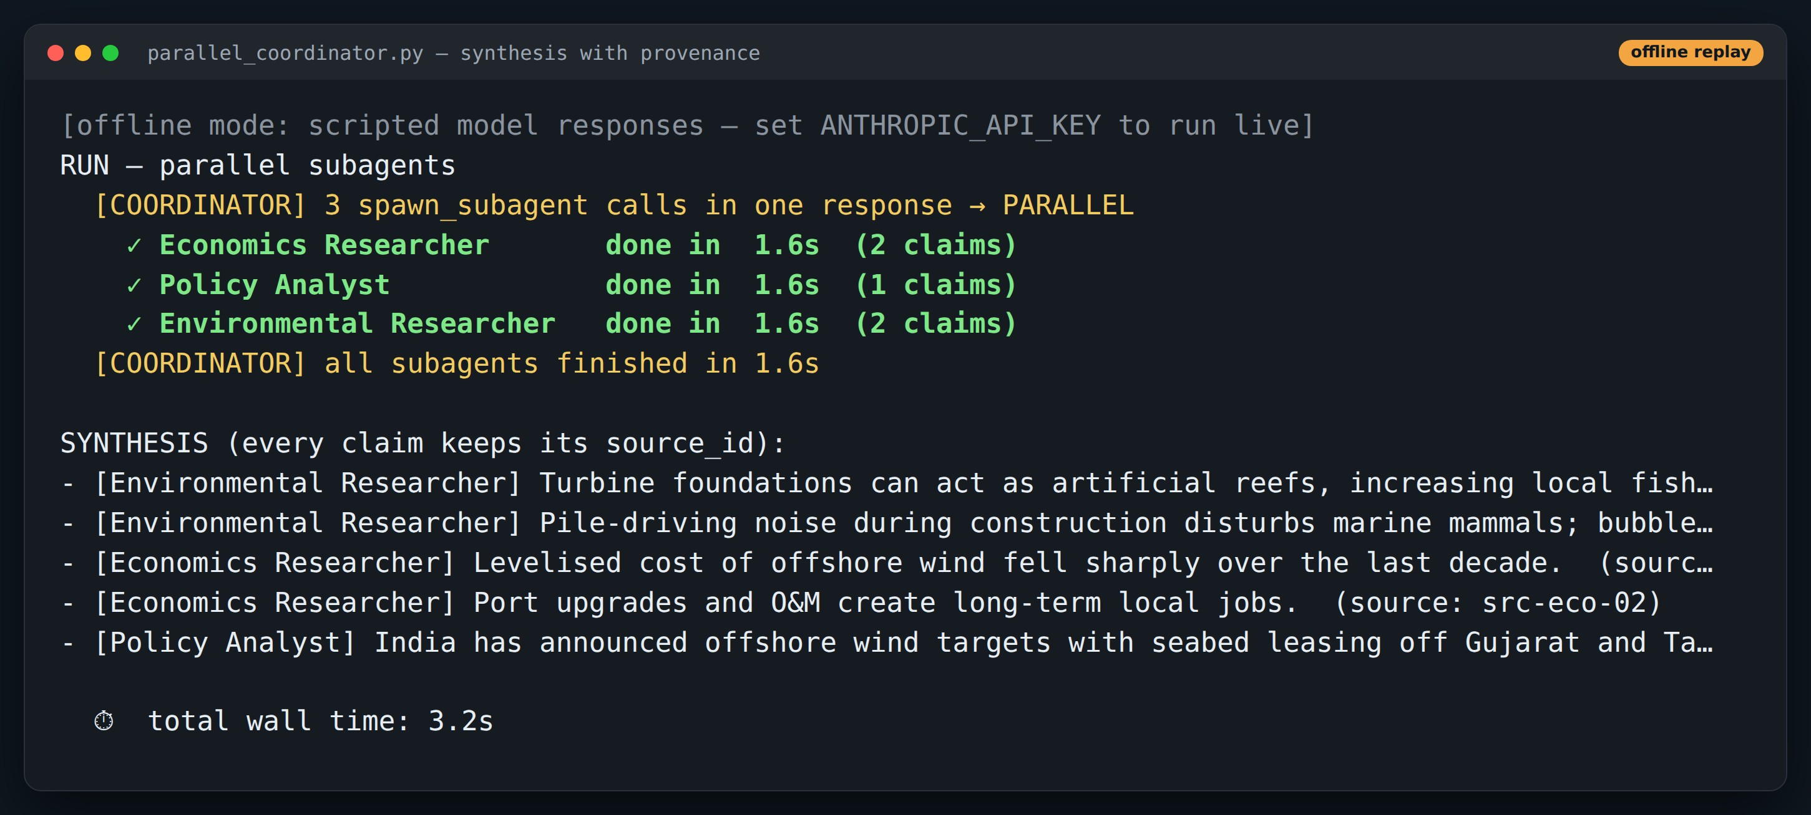
DEMO
Synthesis keeps provenance
Point at
1
Every claim still carries its source_id
2
Grouped by the subagent that found it
3
Conflicts get flagged, not averaged
Offline replay: real demo code, scripted model responses. Re-run with ANTHROPIC_API_KEY for live output.
Notes:
Preview of Part 3: structured findings let the coordinator cite and reconcile.

Slide 27
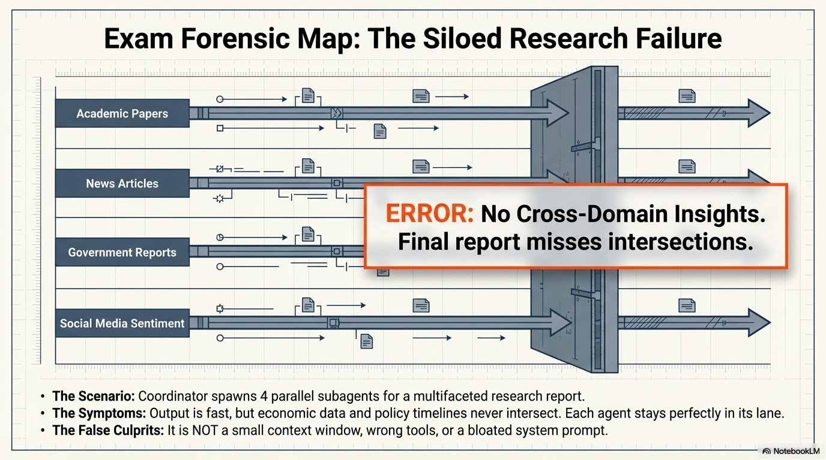
Notes:
Parallel silos: each agent is right in its lane, but nobody connects the lanes.

Slide 28
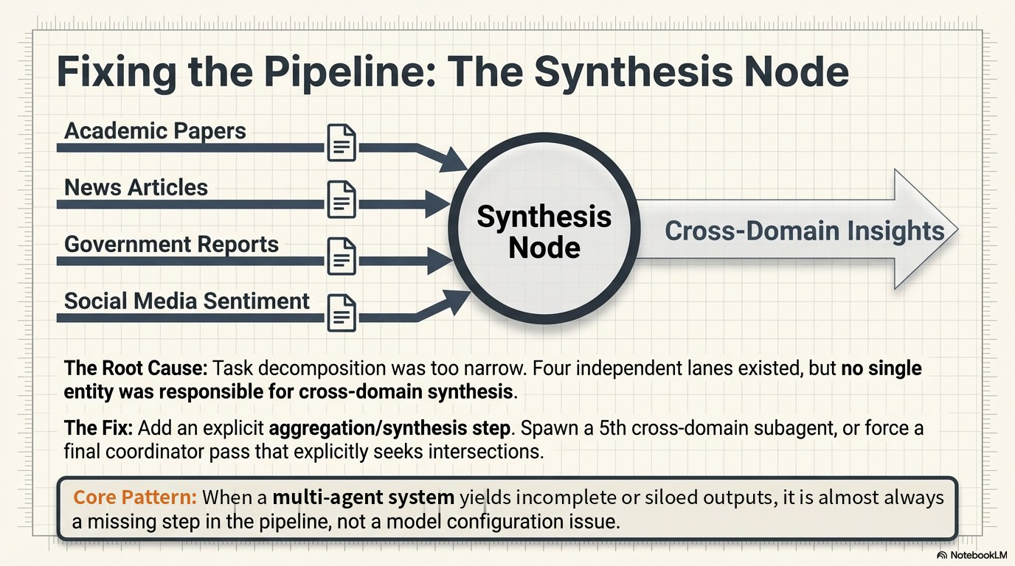
Notes:
Fix: an explicit synthesis step that receives all findings with their structure intact.

Slide 29
3
PART 3
Context & handoffs
Subagents wake up blank. What you hand them is all they know.
≈ 25 min

Slide 30
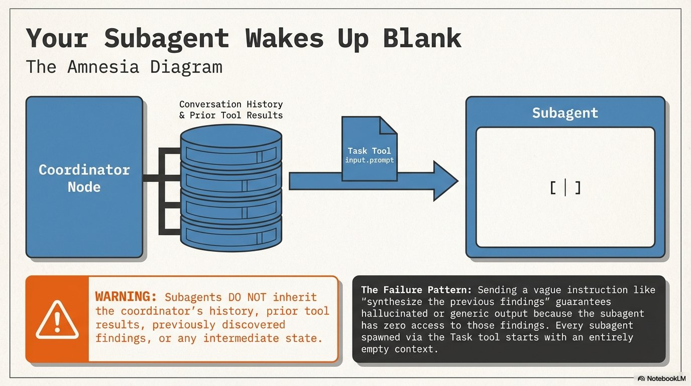
Notes:
No shared memory. If the coordinator doesn't write it into the prompt, the subagent doesn't have it.

Slide 31
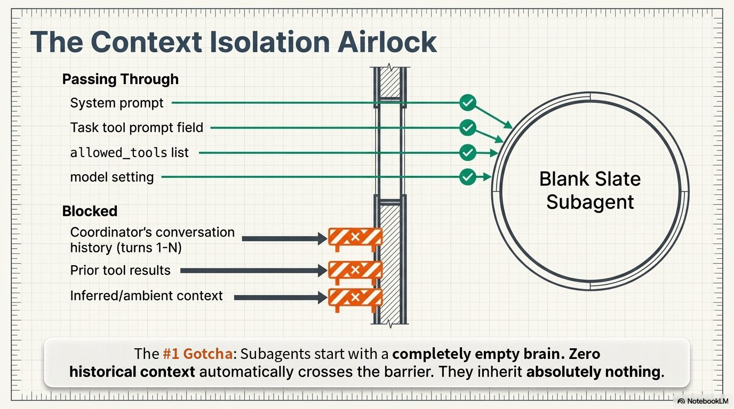
Notes:
Passes: system prompt, task prompt, allowed tools, model. Blocked: history, prior tool results, anything implied.

Slide 32
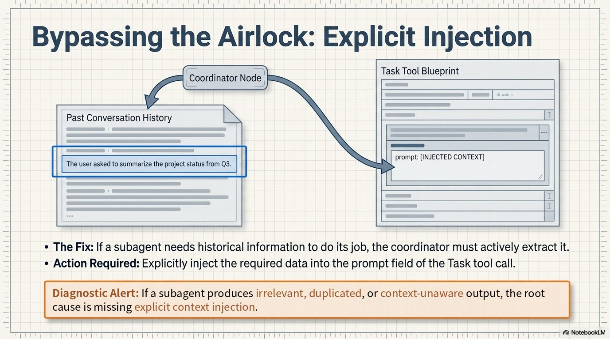
Notes:
When a subagent needs earlier information, the coordinator must copy it into the prompt explicitly.

Slide 33
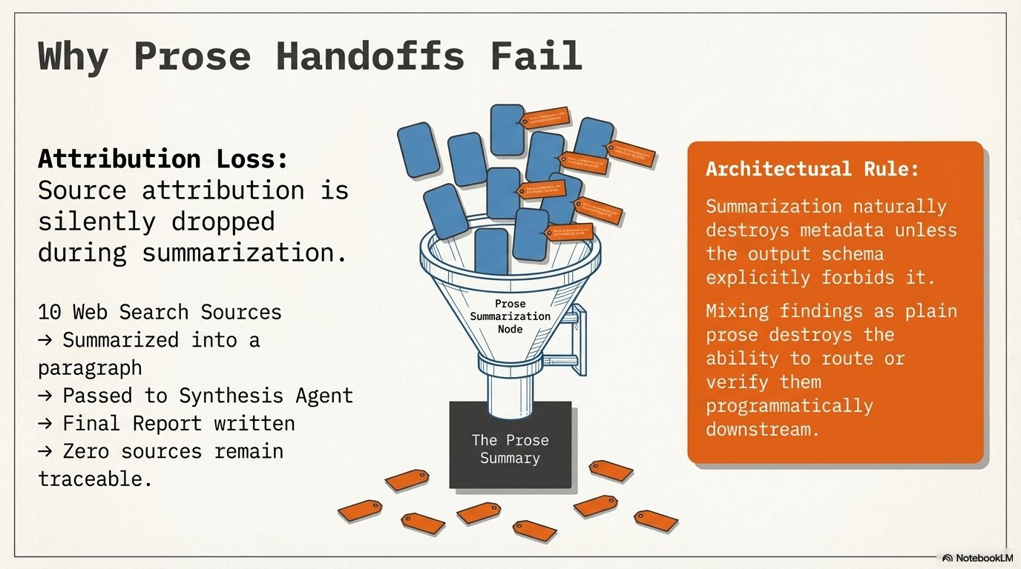
Notes:
Prose summaries lose who said what and where it came from.

Slide 34
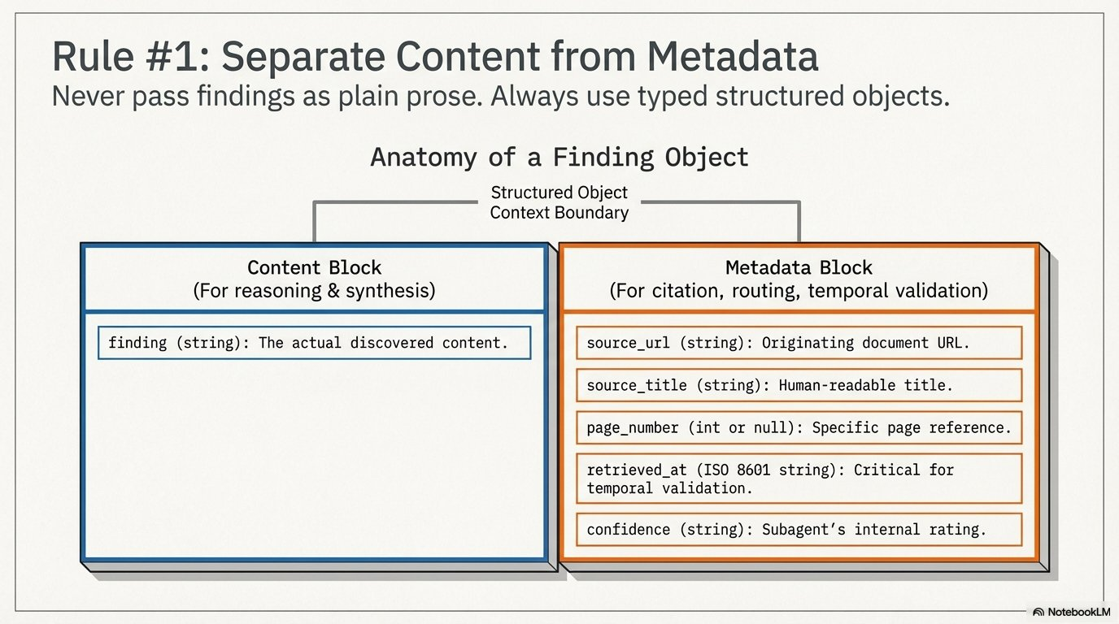
Notes:
Separate content from metadata: finding, source, date, confidence.

Slide 35
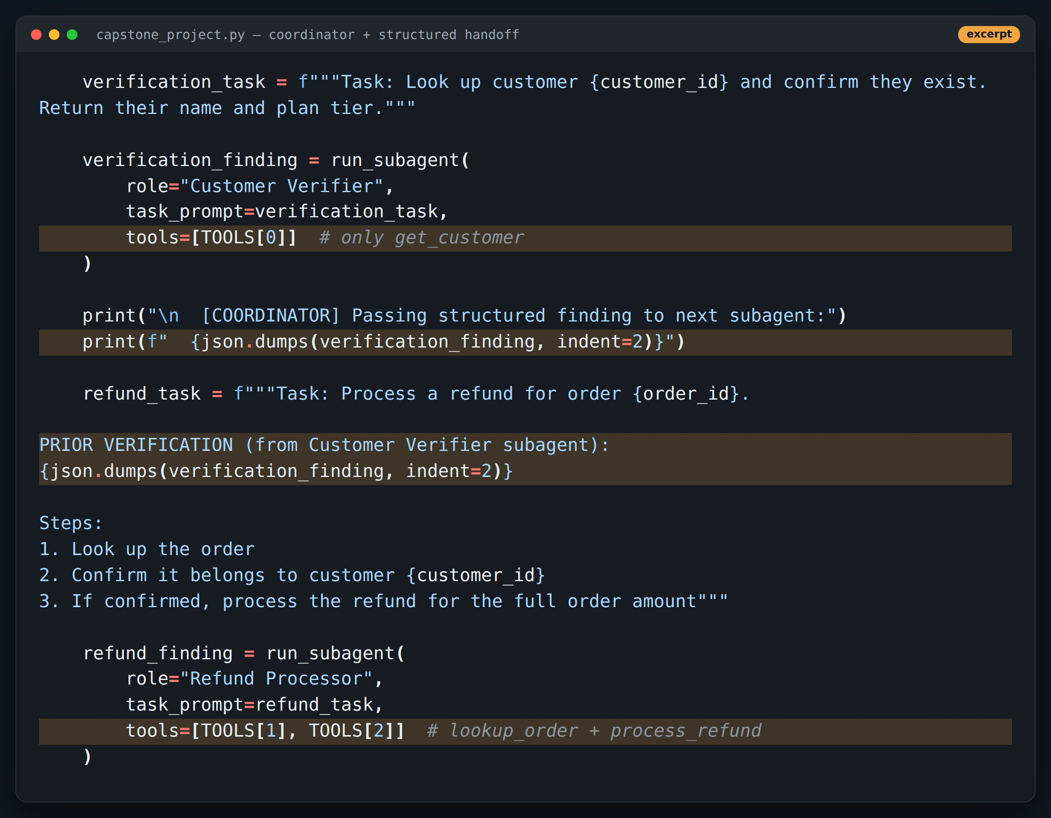
CODE
The capstone coordinator hands off a typed finding
Point at
1
Verifier gets only get_customer
2
Its finding is passed as JSON, not prose
3
Refund Processor gets only lookup_order + process_refund
Code excerpt, comment lines trimmed.
Notes:
Context isolation by tool scoping and by what we put in the prompt. Point at the TOOLS[0] vs TOOLS[1], TOOLS[2] lines.

Slide 36
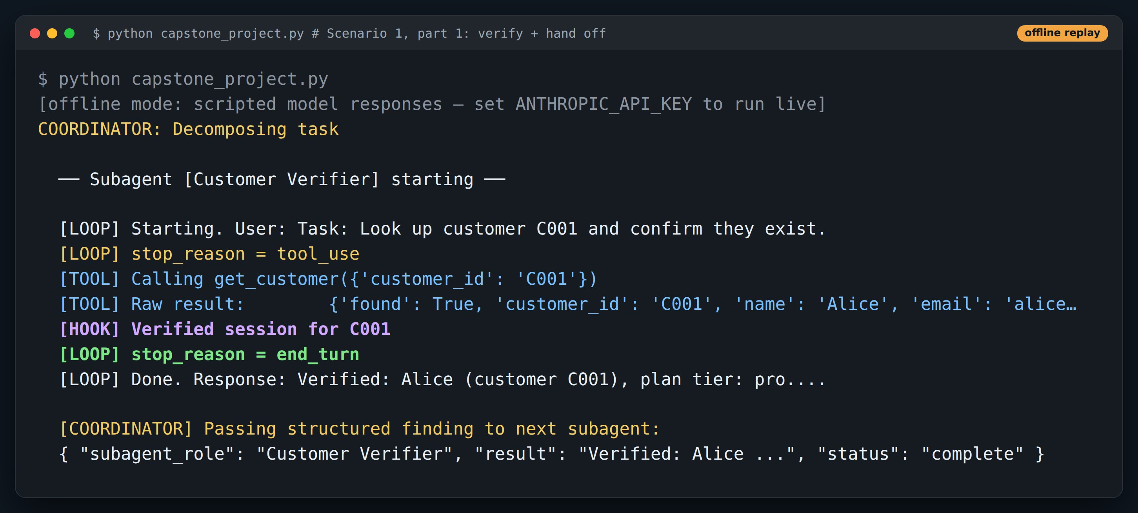
DEMO
Run: verify, then hand off
Point at
1
Subagent 1 calls get_customer(C001)
2
PostToolUse hook marks the session verified
3
Coordinator forwards the structured finding
Offline replay: real demo code, scripted model responses. Re-run with ANTHROPIC_API_KEY for live output.
Notes:
Scenario 1 of the capstone. Next slide shows what happens to the $750 refund.

Slide 37
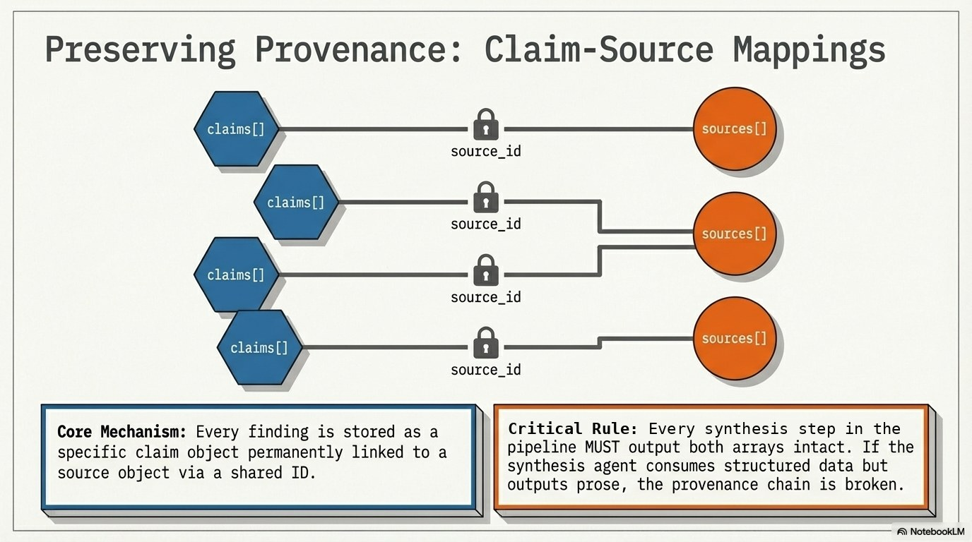
Notes:
Claims link back to sources by id; pass the whole object, never just the claims.

Slide 38
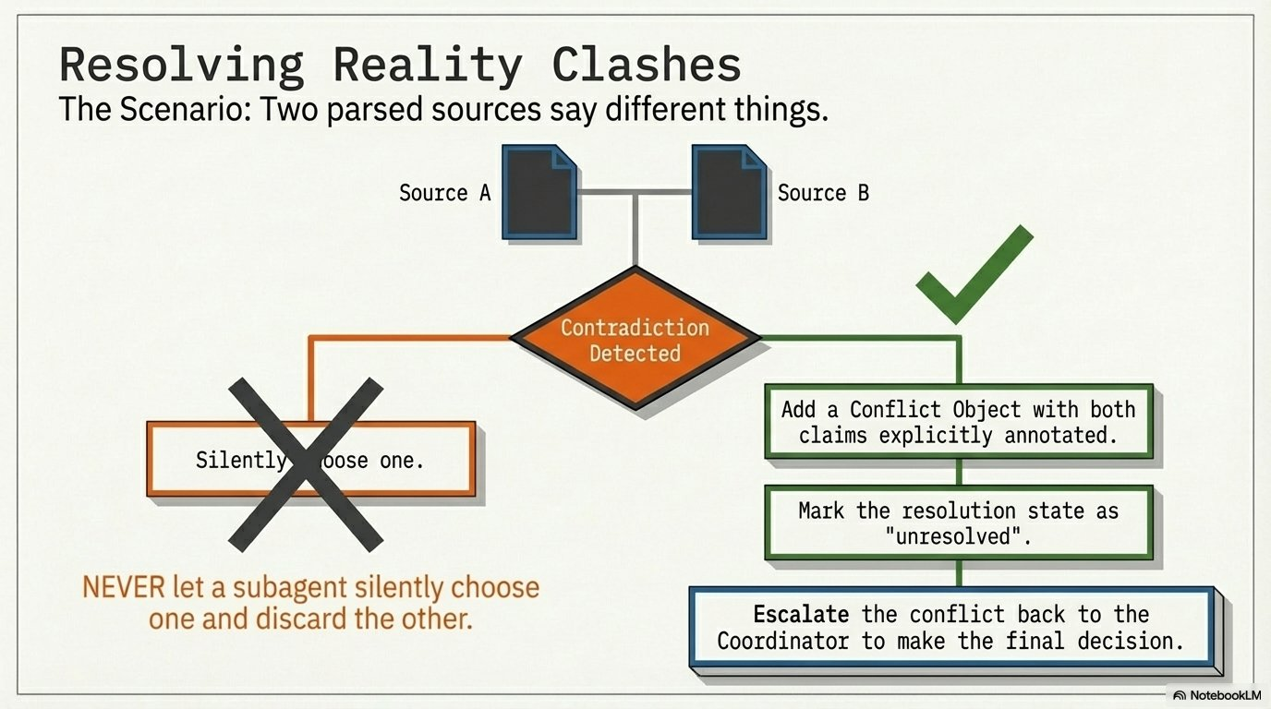
Notes:
When sources disagree, record both. The coordinator (or a human) decides.

Slide 39
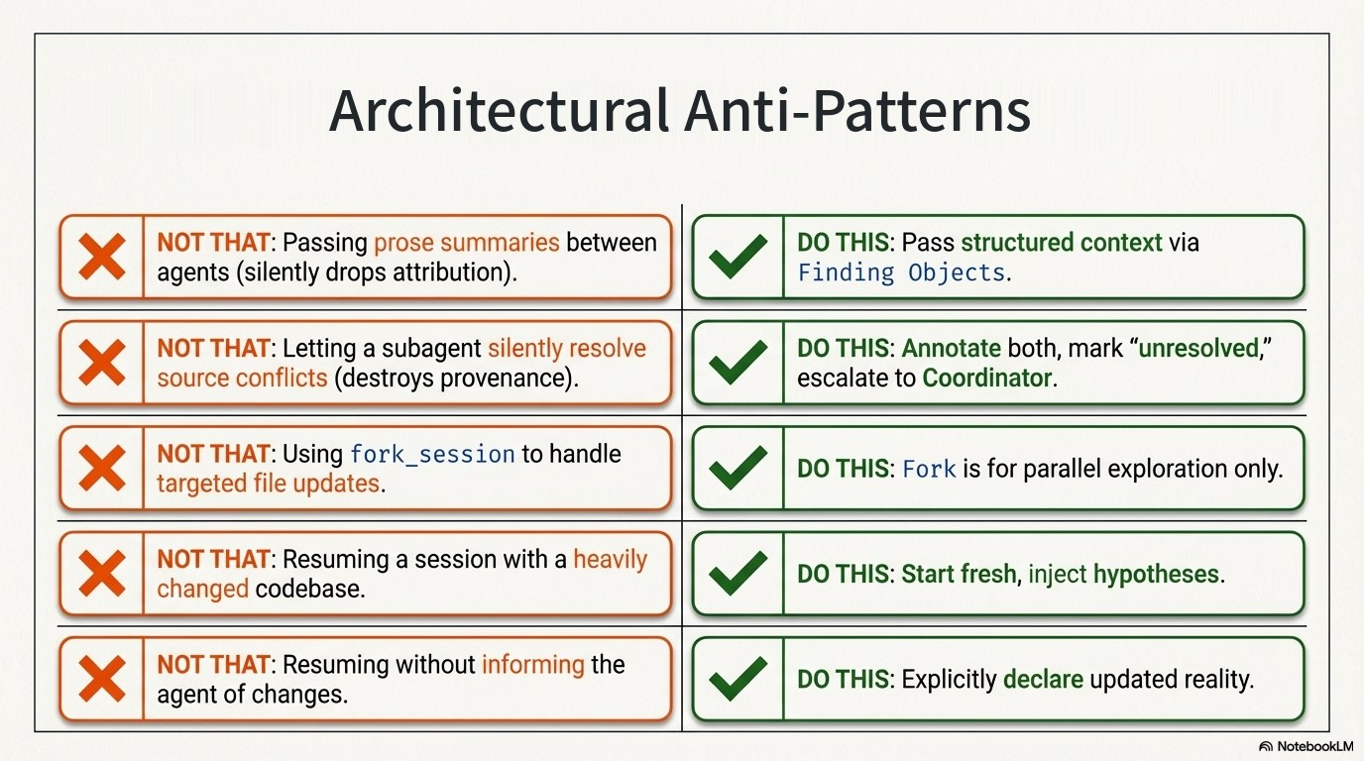
Notes:
Anti-patterns for handoffs and sessions.

Slide 40
4
PART 4
Guardrails
Prompts guide. Code enforces.
≈ 40 min

Slide 41
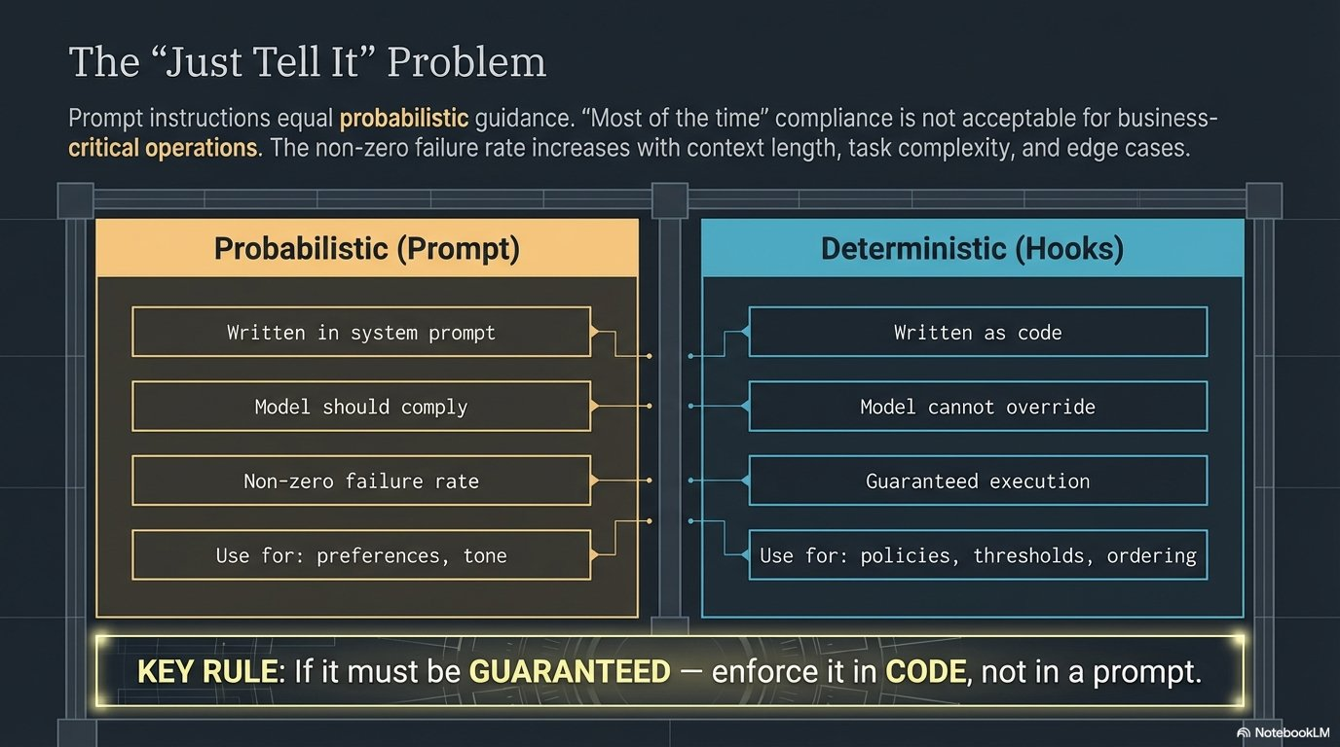
Notes:
"Always verify first" in a prompt works most of the time. For money and data, most isn't enough.

Slide 42
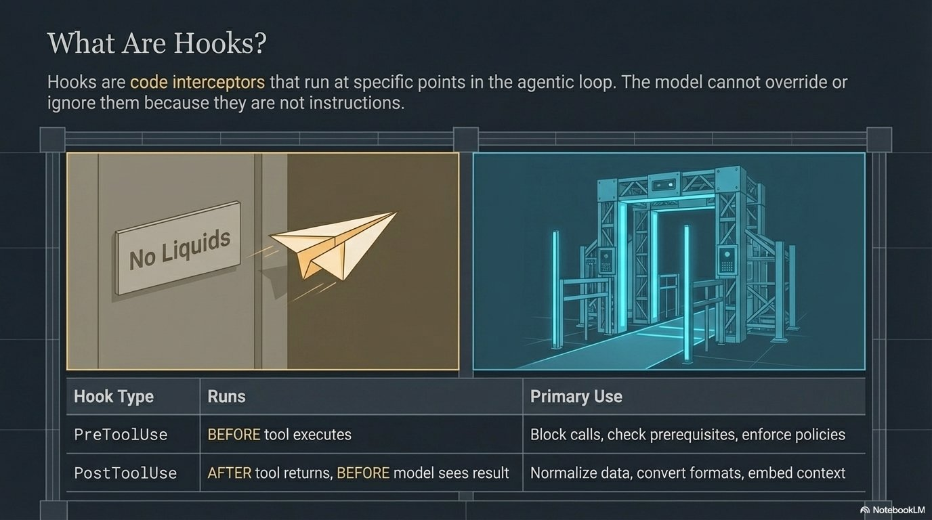
Notes:
Hooks are ordinary code that runs around every tool call. The model can't skip them.

Slide 43
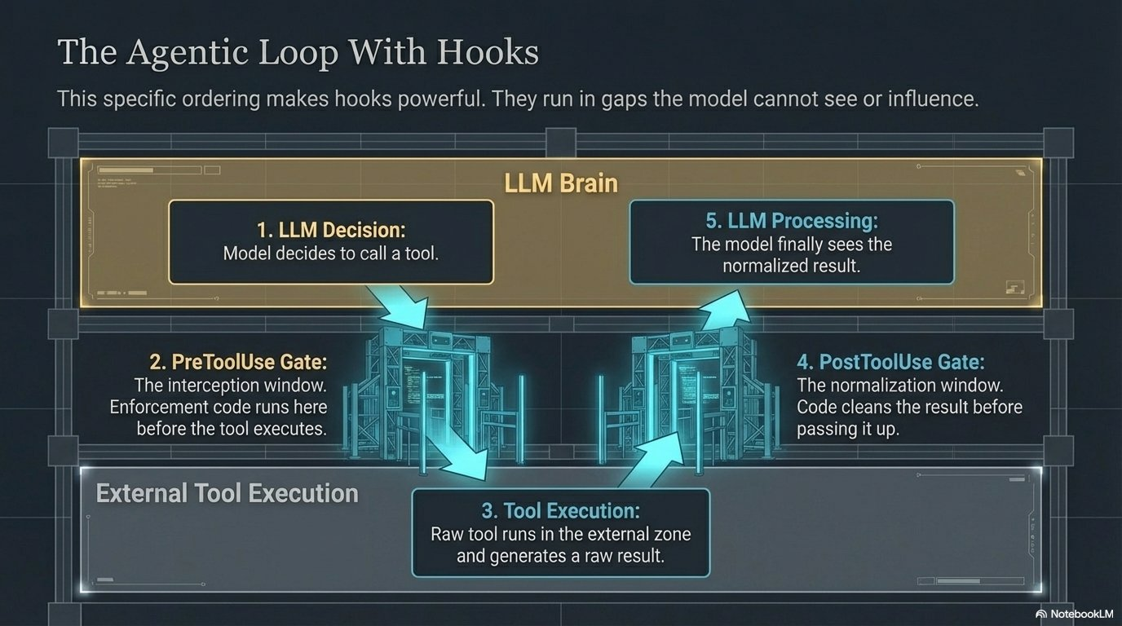
Notes:
PreToolUse runs before execution and can block. PostToolUse runs after and can reshape the result.

Slide 44
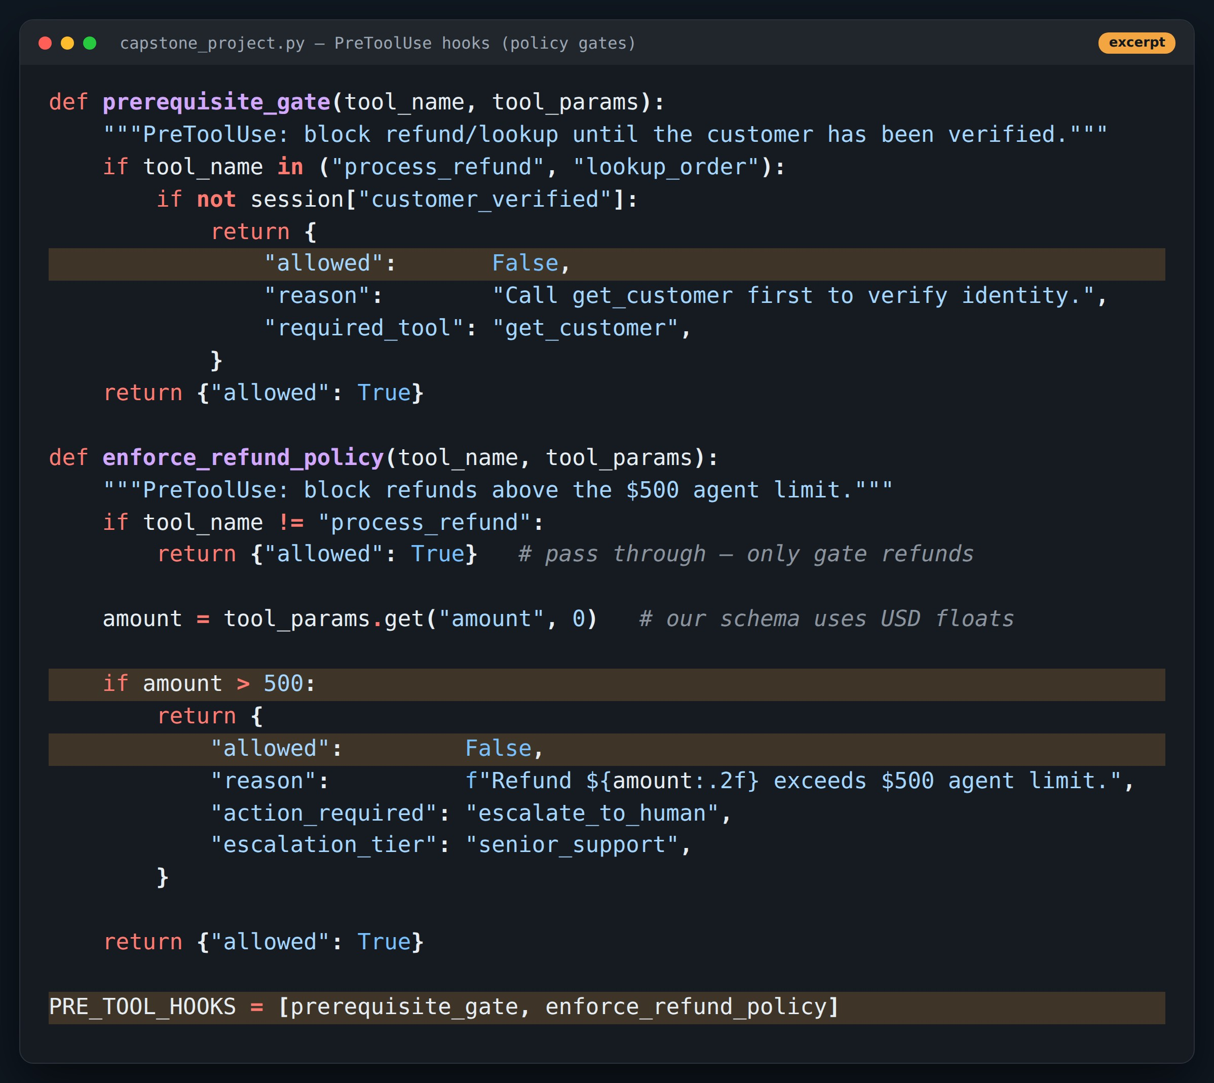
CODE
PreToolUse: two policy gates
Point at
1
prerequisite_gate: no lookup/refund until verified
2
enforce_refund_policy: nothing above $500
3
Order matters: first block wins
Code excerpt, comment lines trimmed.
Notes:
Both return a structured decision the model can read and act on.

Slide 45
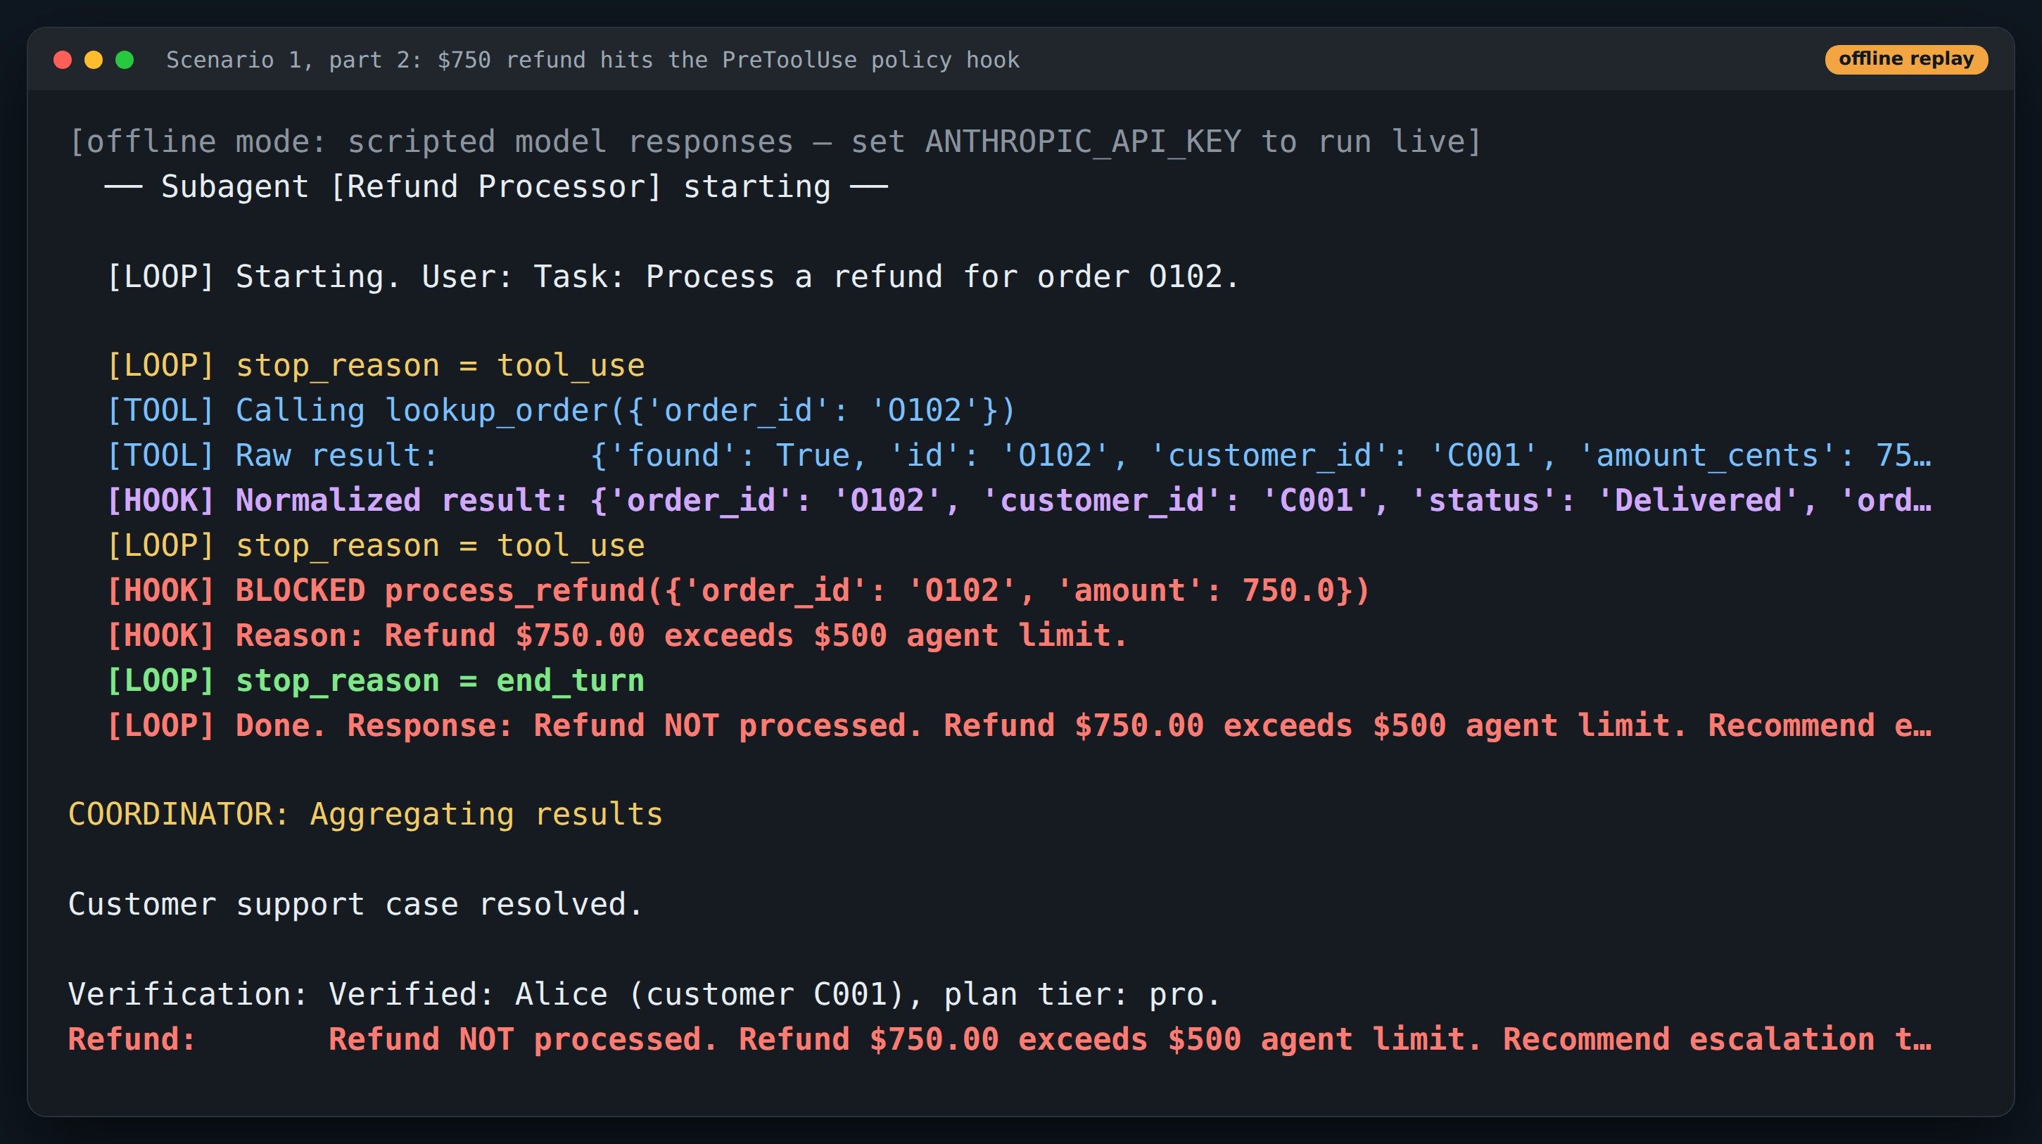
DEMO
Run: the $750 refund gets blocked
Point at
1
PostToolUse turned cents + codes into $750.00, Delivered
2
Model calls process_refund for the full $750
3
Hook blocks it and names escalation as the next step
Offline replay: real demo code, scripted model responses. Re-run with ANTHROPIC_API_KEY for live output.
Notes:
The model did exactly what the tool description said. The hook still caught the policy breach.

Slide 46
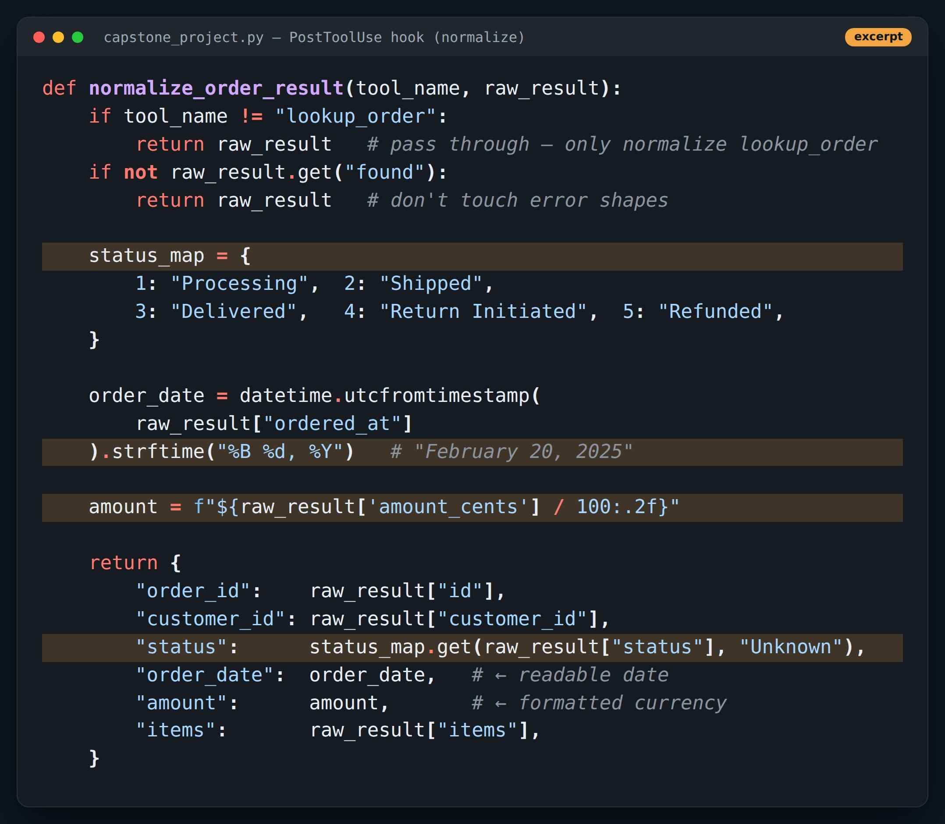
CODE
PostToolUse: clean data before the model sees it
Point at
1
Status code 3 → "Delivered"
2
Unix timestamp → readable date
3
Cents → $ string
Code excerpt, comment lines trimmed.
Notes:
Less for the model to interpret means fewer wrong interpretations and fewer tokens.

Slide 47
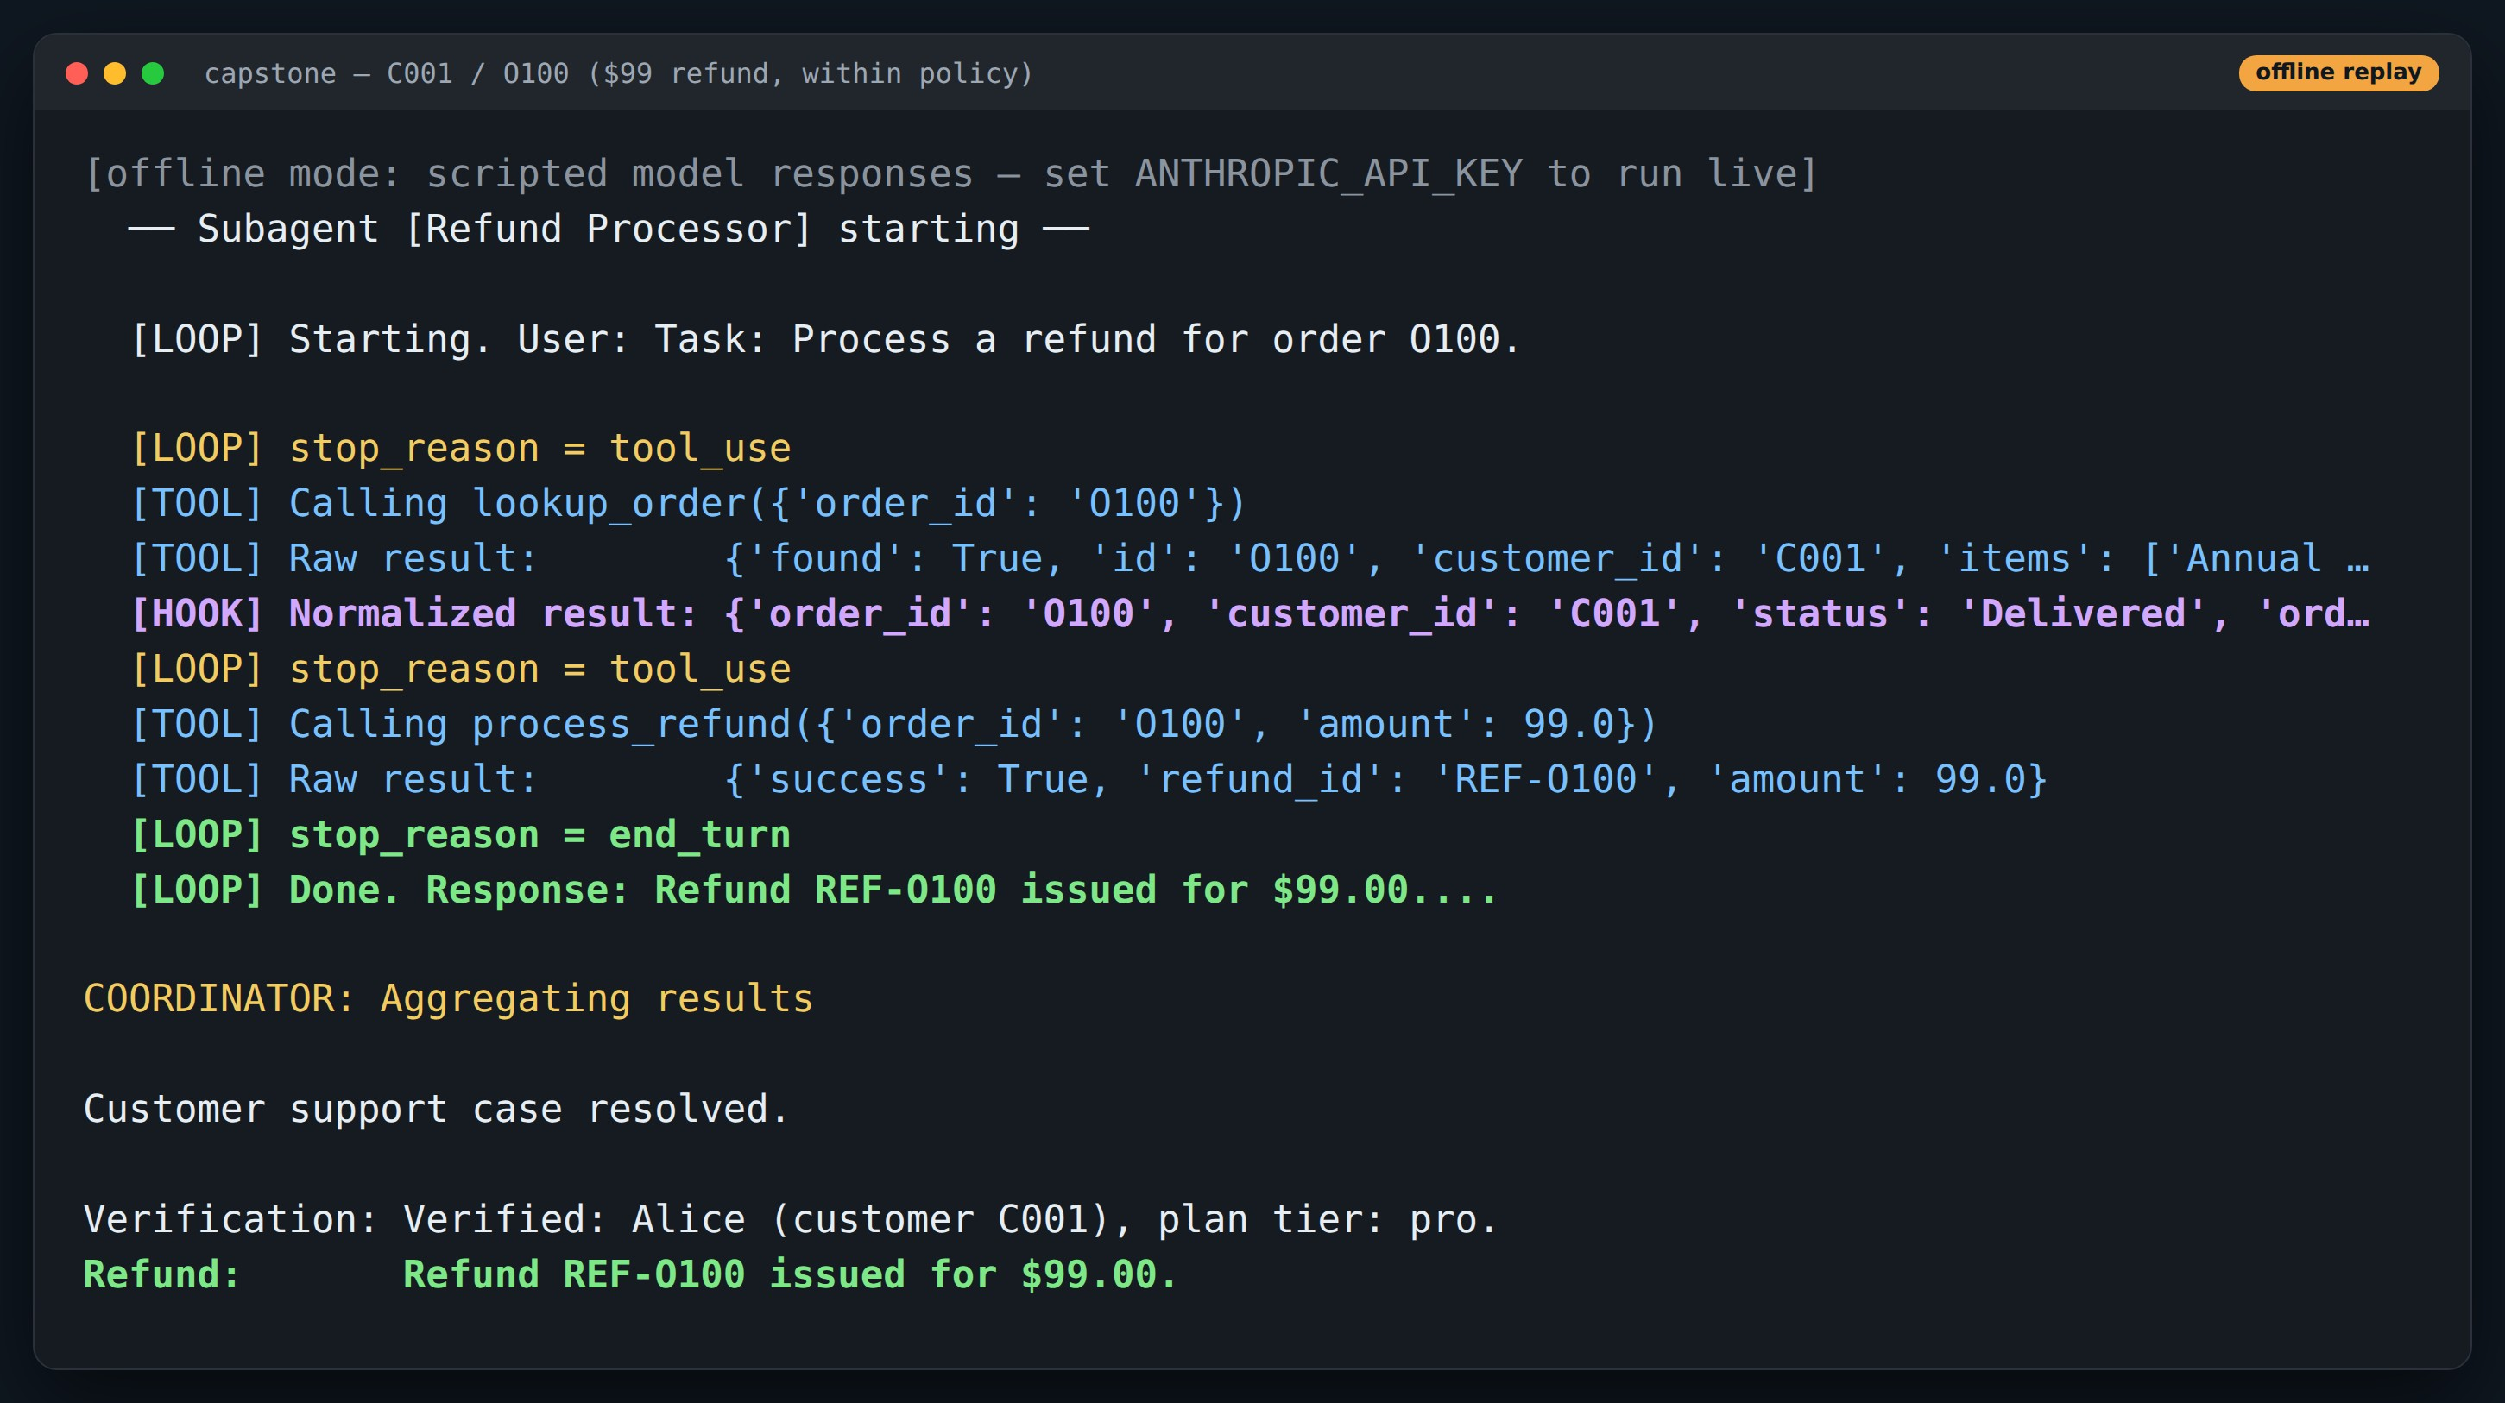
DEMO
Run: a $99 refund goes straight through
Point at
1
Same code, order O100
2
Both gates allow it
3
Refund REF-O100 issued
Offline replay: real demo code, scripted model responses. Re-run with ANTHROPIC_API_KEY for live output.
Notes:
Show that guardrails don't get in the way of the normal path.

Slide 48
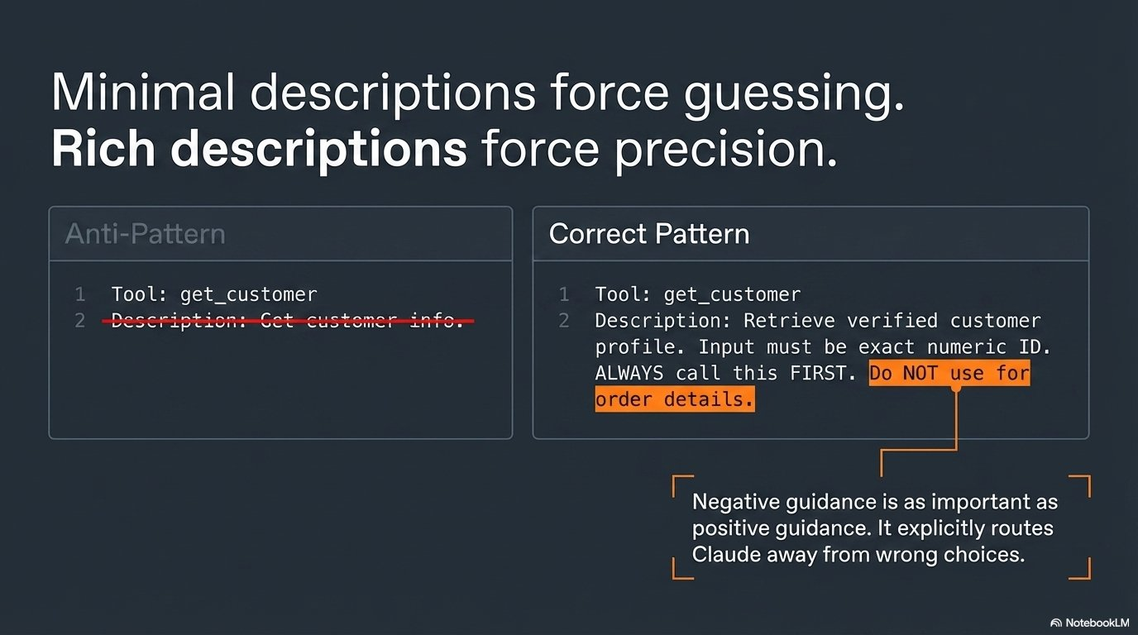
Notes:
Tool descriptions are how the model routes. Thin descriptions mean guessing.

Slide 49
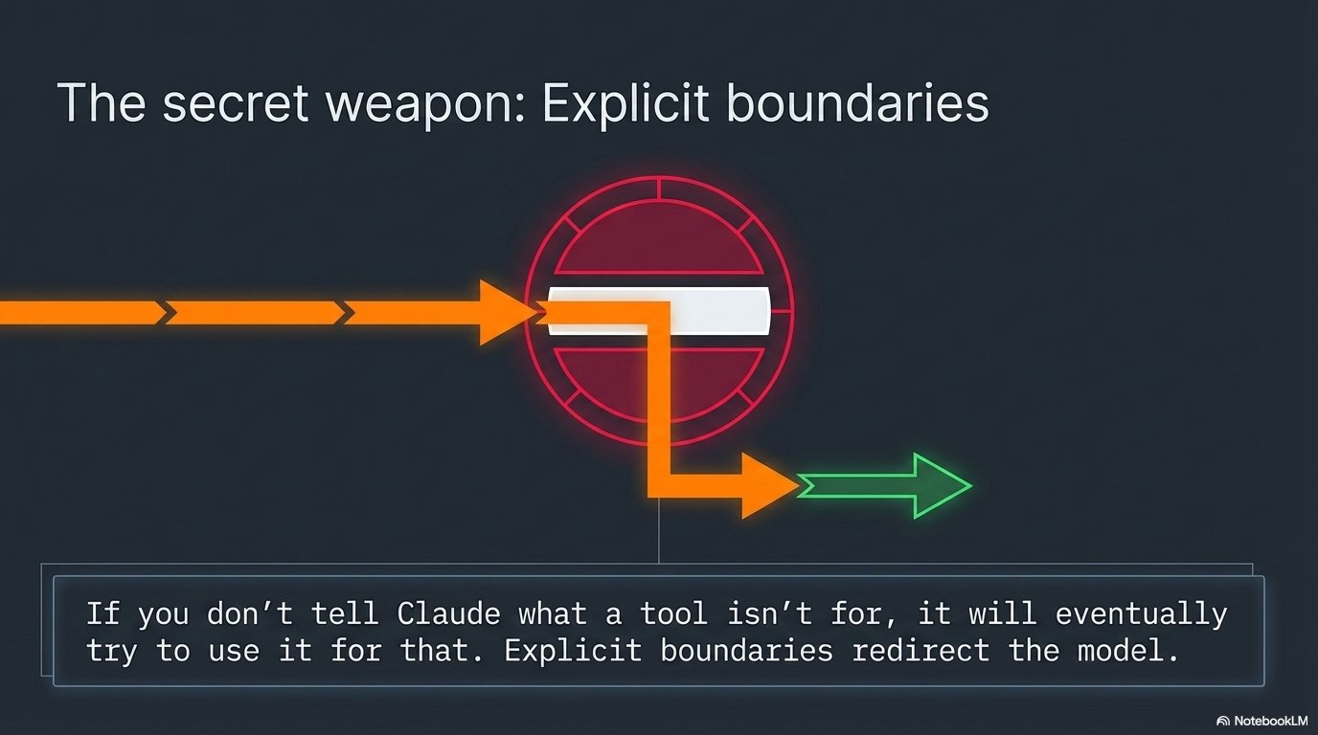
Notes:
Say what the tool is NOT for. It's the cheapest fix for misrouting.

Slide 50
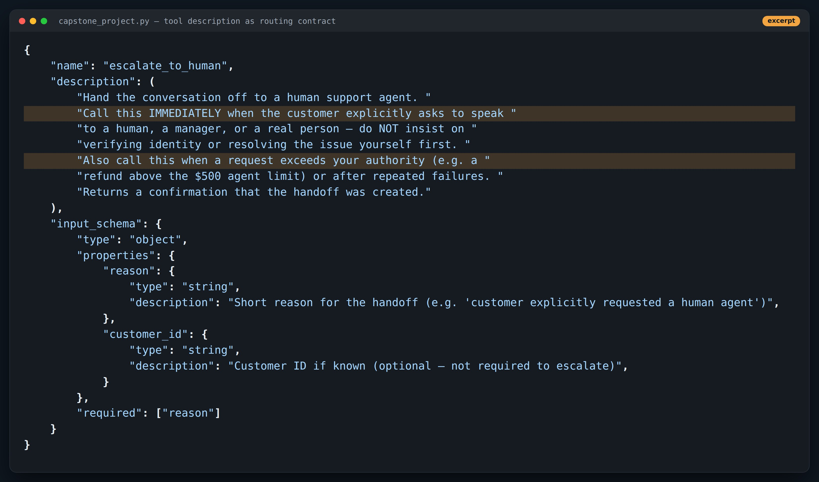
CODE
A description that encodes policy
Point at
1
When: immediately on an explicit request
2
When: beyond authority, or repeated failures
3
What not: don't insist on verification first
Code excerpt, comment lines trimmed.
Notes:
This is the escalate_to_human tool from the capstone.

Slide 51
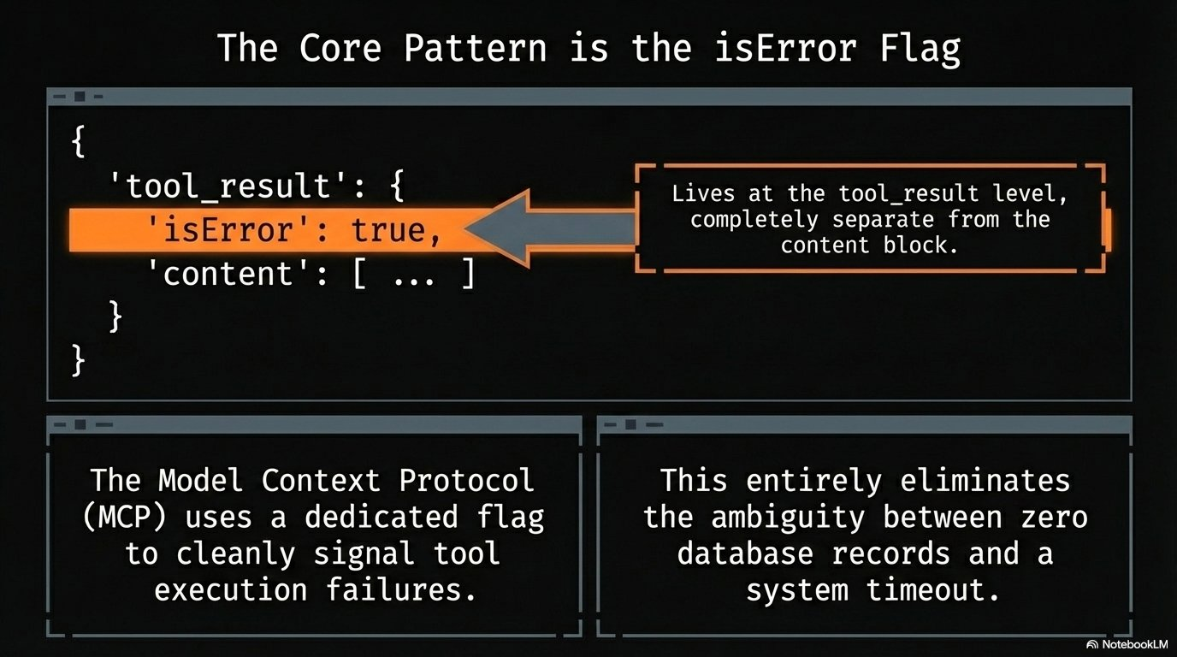
Notes:
Tool failures go back as tool_result with is_error: true. Never raise into the loop.

Slide 52
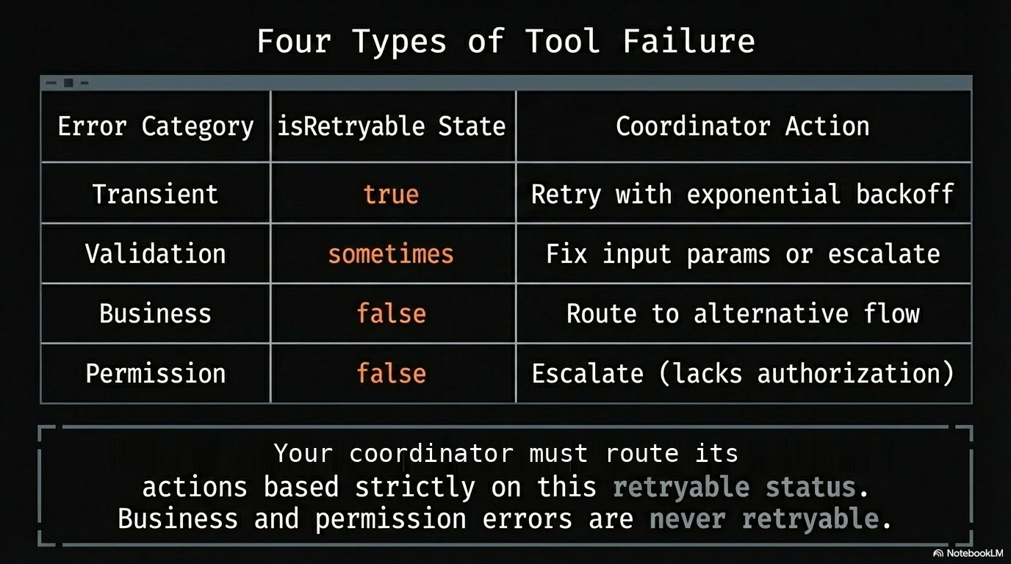
Notes:
Four categories, each with a different recovery action.

Slide 53
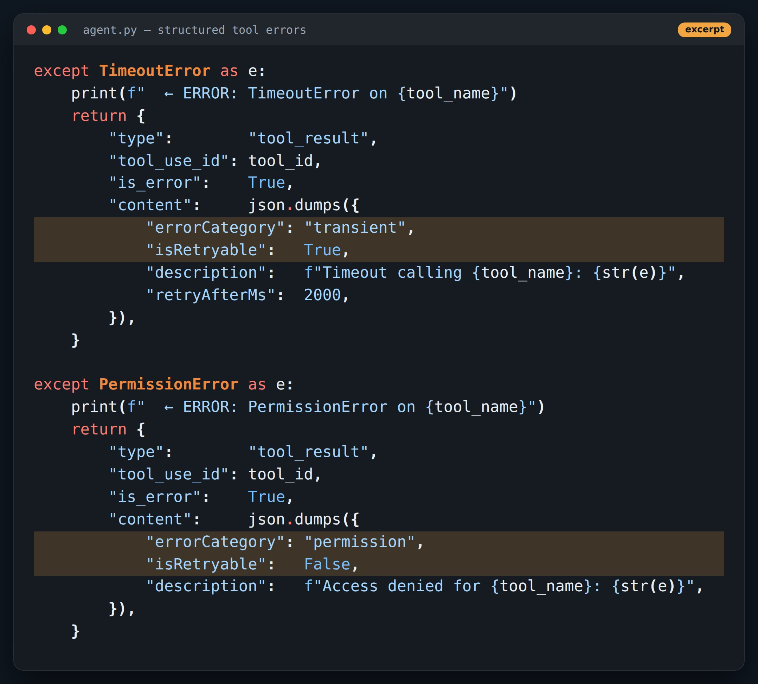
CODE
Errors the model (and coordinator) can act on
Point at
1
errorCategory drives the recovery path
2
isRetryable: retry vs rethink
3
retryAfterMs for transient faults
Code excerpt, comment lines trimmed.
Notes:
Structured errors are what let a coordinator decide: retry, reroute, or escalate.

Slide 54
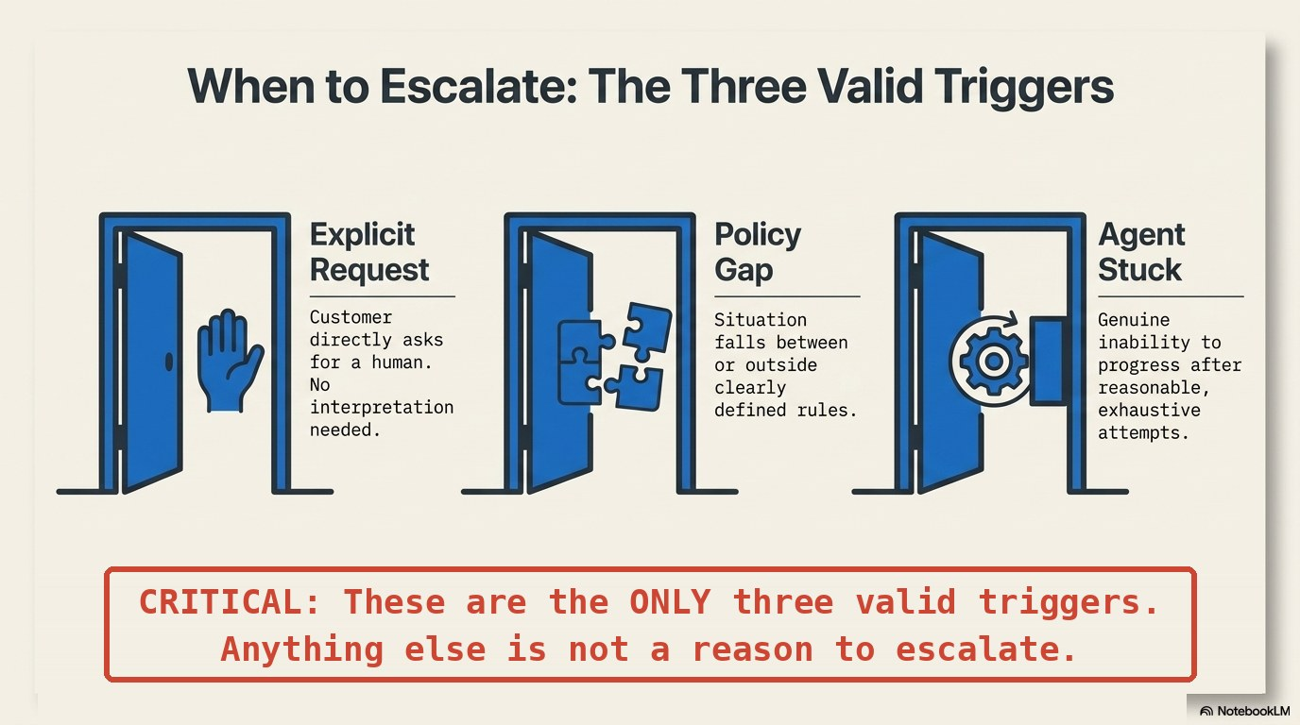
Notes:
Three valid reasons to hand off to a human.

Slide 55
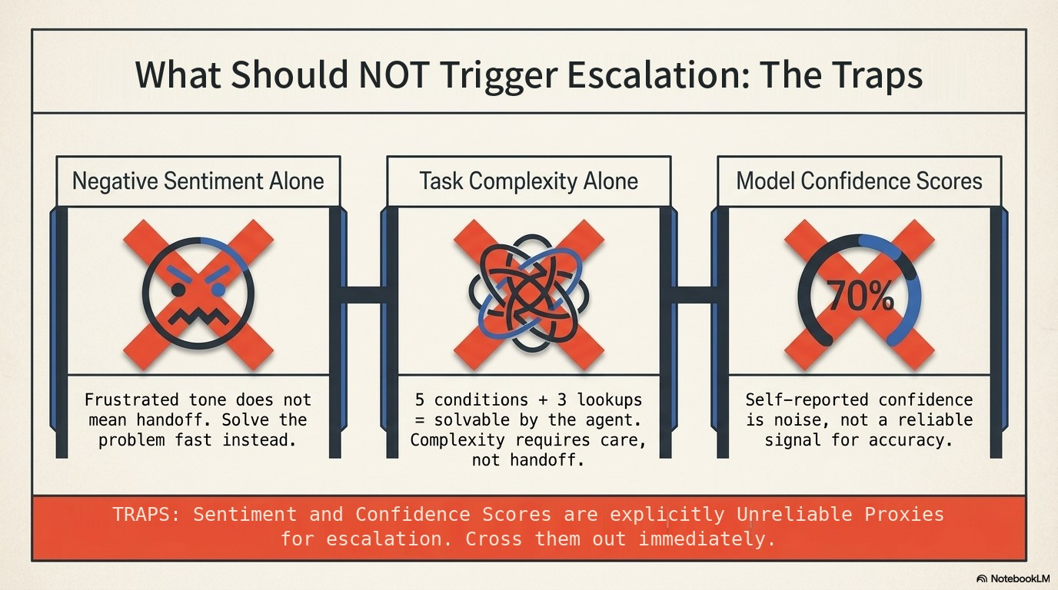
Notes:
Frustration, complexity and self-reported confidence are not reasons on their own.

Slide 56
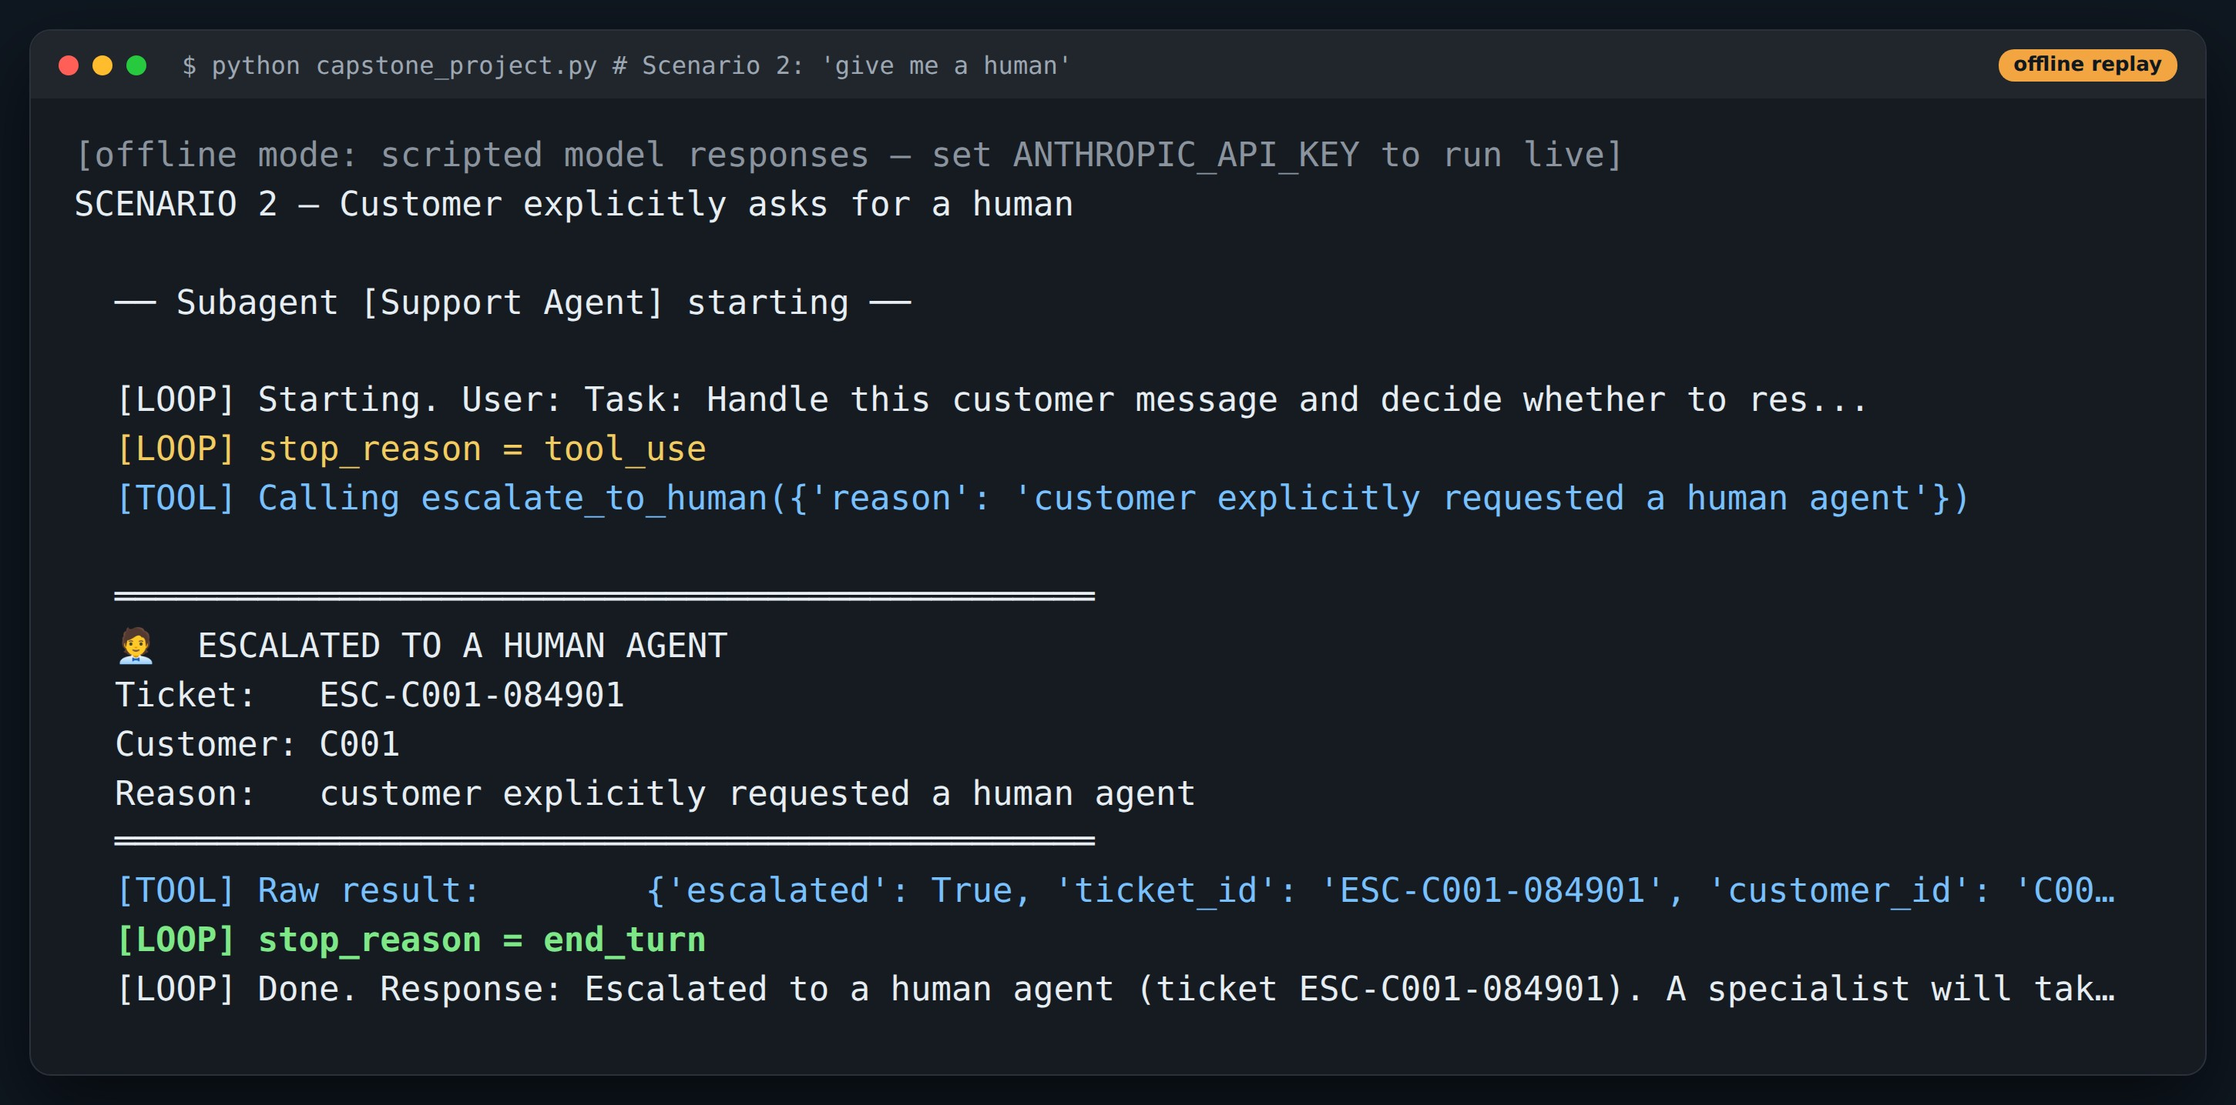
DEMO
Run: “I want a real human”
Point at
1
Full toolset available
2
Model picks escalate_to_human first
3
No forced verification before handoff
Offline replay: real demo code, scripted model responses. Re-run with ANTHROPIC_API_KEY for live output.
Notes:
Explicit requests are honoured immediately. Keep this screen for the bug hunt — look at the Customer line.

Slide 57
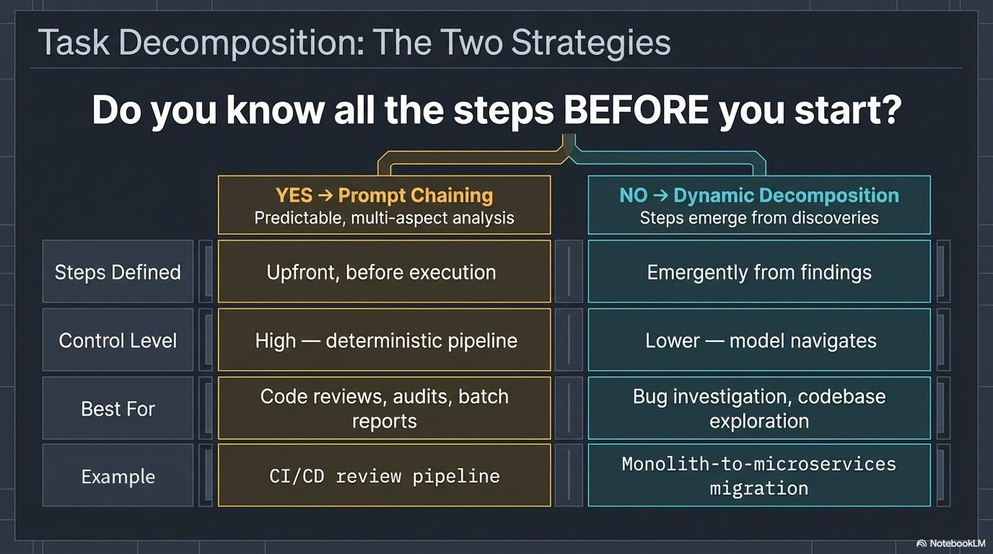
Notes:
If you know the steps up front, chain prompts. If the steps depend on what you find, decompose dynamically.

Slide 58

Notes:
Incident investigation is the classic dynamic case.

Slide 59
5
PART 5
Reliability at scale
Failures that don't crash are the ones that hurt.
≈ 30 min

Slide 60

Notes:
Multi-agent systems fail quietly: no exception, just a wrong or empty answer.

Slide 61

Notes:
"Operation failed" gives the coordinator nothing to decide with.

Slide 62

Notes:
What a subagent's error should carry back.

Slide 63

Notes:
Zero results and a broken source are different outcomes and need different signals.

Slide 64

Notes:
Recover locally first; escalate with full context when local options run out.

Slide 65

BUG HUNT
Everything failed. The coordinator says “resolved”.
What happened
Customer C999 doesn't exist. The gate correctly blocks the lookup.
The bug
run_subagent() always returns status: "complete", and coordinator() never checks it before continuing.
Fix
Return a status + errorCategory from each subagent; stop or escalate on failure.
Found by running the capstone with customer C999. Offline replay.
Notes:
Ask the room to find the bug before revealing the panel. This is exactly the error-propagation failure from Lesson 19, in the course's own capstone.

Slide 66

Notes:
After many tool calls, early findings get buried and forgotten.

Slide 67

Notes:
Models attend best to the start and end of context. Put key facts there.

Slide 68

Notes:
A case-facts block pinned at the top, updated as the agent works.

Slide 69

Notes:
Scratchpad files persist findings outside the context window.

Slide 70

Notes:
Provenance must survive every agent boundary.

Slide 71

Notes:
Annotate both sides of a conflict; don't silently pick one.

